Slide 1
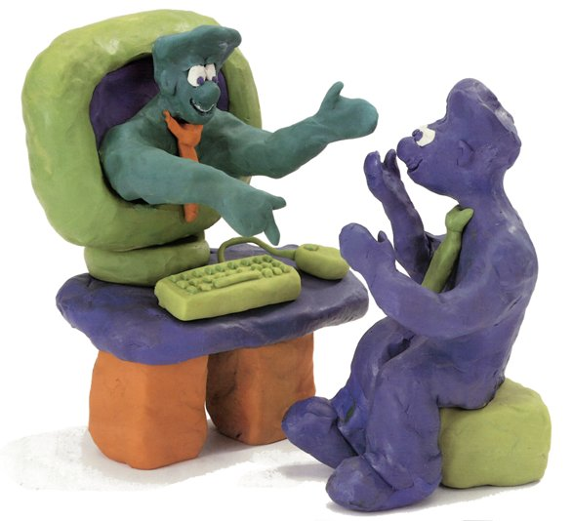
Learners’ eLearning competency 1/1
Component
Training (over 50 and at least 3 levels)
Communication and collaboration
literacy
Recognized
Forgotten
ICT literacy
Education culture literacy
Whole task training
(integrate within teaching modules)
Metacognitive competency
Popular
Nurturing eQ (Elearning intelligence,
Change pedagogy and use of ICT)
Recognized
Daniel K. Schneider et al.
daniel.schneider@unige.ch
TECFA

Slide 2
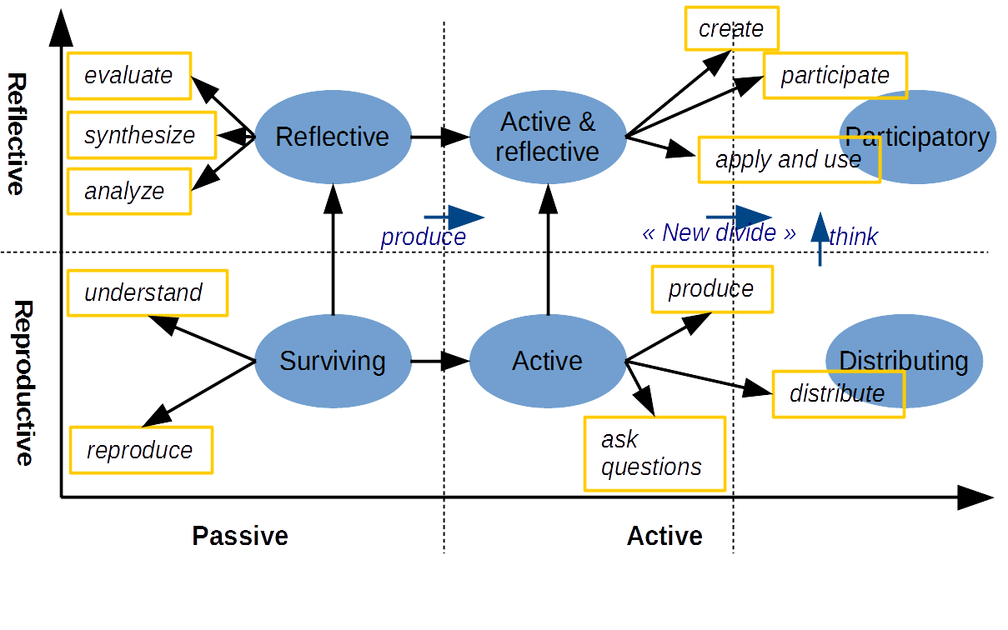
Learners’ eLearning competency 2/2
(Inspired by Lin et al, 2013)
Daniel K. Schneider et al.
daniel.schneider@unige.ch

