Slide 1
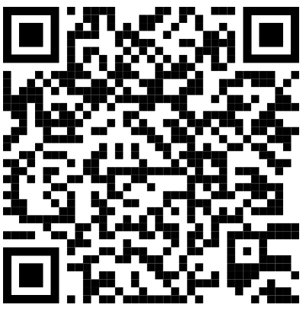
One step away: embracing OER in libraries as a key element of Open Science
Swiss Library Network for Education and Research
Bern, 26.09.2024
Barbara Class , UNIGE & Mathilde Panes, HEP Vaud

Slide 2
A keynote on Openness in two parts
Part 1: Conceptual and historical background
Part 2: Closer to librarians’ reality

Slide 3
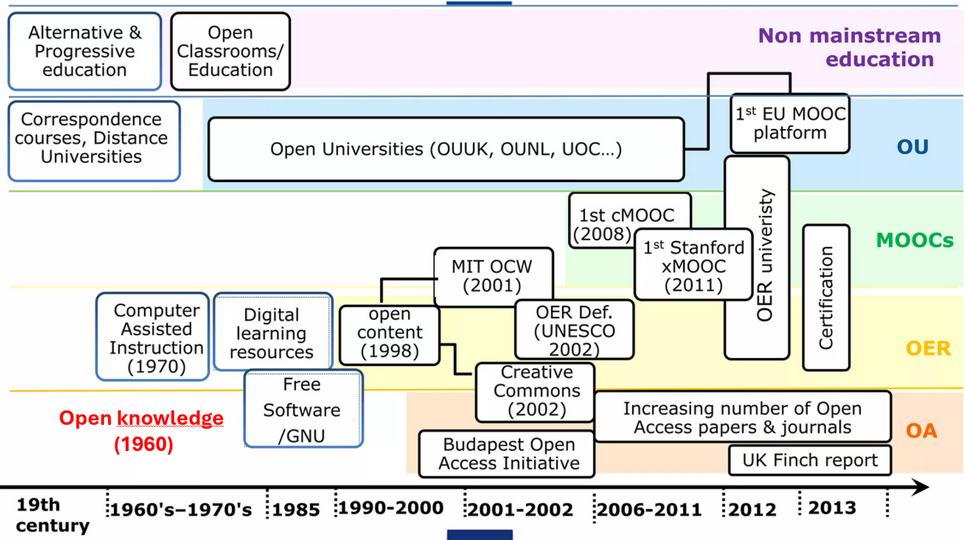
Where do Open Science and Open Education come from?
University of Bologna
Foundation – student led. Teaching focused.
Academic freedom created to protect the Universitas
Open Society
Henri Bergson, Les Deux sources de la morale et de la religion
Karl Popper, The Open Society and its Enemies
Copyright on software in public law
Started under the 1976 Act, software is under copyright in the USA
Web created at CERN
Connect researchers worldwide – Collaboration, Compassion, Creativity
Split of the Free software movement into Open Source
Social movement vs development methodology
1088
1932 & 1945
1950/60
1980
1985
1989
1992
1998
2008
Computers / Internet Open Knowledge
Code is openly shared, working together to understand this new science
Free software
R. Stallman creates the Free software as a social movement with copyleft as a tool
Public domain
Copyright creates the legal concept of public domain
First cMooc
Connect massively worldwide and create knowledge together
Punie, 2014

Slide 4
Openness: the many conceptions
“Despite the illustrious history of openness as the cornerstone of liberal thinking, the 2020s are not a time for naïve calls for ‘openness for its own sake’, whatever that may mean. As the Internet becomes a playground for corporate monopoly and fake news threatens to overwhelm attempts at earnest debate, the dangers and misuses of the idea of free information have become apparent for all to see.”
Leonelli, 2023, p. 3

Slide 5
1088: the Bologna Universitas
Universitas
Aim: Create new knowledge
Protection device: Academic Freedom
Decentralised form &
Grassroot movement
Masters
City of Bologna
De Meulemeester, 2011
Paul, 2014
Rangel, 2007
Scott, 2006

Slide 6
Enclosure 1
Middle Ages
Open = “commons-oriented”, e.g. Open Field
i.e. integrated social organism, relational dynamics
Freedom to use
XVIth – XIXth Enclosure
Legal property
Copyright (1710 Statute of Anne)
Pomerantz
Bollier, 2024
https://en.wikipedia.org/wiki/Inclosure_acts

Slide 7
The concept of Open Society: Open is back
Bergson - 1932 | Popper - 1945
Open society, inclusive of the entire humanity - opposed to a closed society | Open and liberal society, focusing on freedom and democracy – opposed to a totalitarian society
Dynamic, creative, universal oriented moral which aims at peace. Uses intuition and imagination. | Scientific oriented with rational thinking, experience, and the value of critical thinking in the scientific process
Henri Bergson, Les Deux sources de la morale et de la religion
Karl Popper, The Open Society and its Enemies
Bergson, 1932
Popper, 1945

Slide 8
1950/60: Open Knowledge
Begining of computers and informatics
Universities are early adopters
They apply their sharing culture to advance this new science
Technology is dencentralisation-oriented and facilitates sharing (Internet, Hypertext)
Librarians are involved (ERIC Education Resources Information Center )
Open Knowledge takes the form of peer production and peer governance to advance new knowledge
1970-1980 Copyright on software
Serial crisis
Peters, 2016
https://oad.simmons.edu/oadwiki/Timeline Peter Suber
https://digital-law-online.info/lpdi1.0/treatise17.html

Slide 9
1980s: 4th key historical moment of Openness
1985: Free software movement created
Continuing decentralized forms of knowledge production
Copyleft to create information commons
1989: World Wide Web THE technology to empower Open Knowledge
Aim: Information sharing wolrdwide among scientists
Values: Collaboration, Compassion, Creativity
1991: ArXiv Open Access grassroot initiative
Enclosure 2
1992/3 Public domain is created in European law
Peters, 2016
Berners-Lee, 2024
Bibliothèques et communs de la connaissance, 2014
https://fr.wikipedia.org/wiki/Enclosure_des_communs_informationnels

Slide 10
1998: Split of the Free software movement
Free software | Open source software
Copyleft, decentralised | Copyleft, decentralised
Social movement | Development methodology
Relational, connection-oriented | Transactional, resource and object-oriented
Grant users Freedoms | Grant users Rights
Holistic paradigm? | Mechanistic paradigm?
Bollier, 2024; Leonelli, 2023; Peters, 2016; Sterling, 2021

Slide 11
Does paradigm matter?
Paradigm = underlying set of perceptions, assumptions, values, and concepts with internal consistency
Paradigm shapes purpose and determines practice and policy
Two major paradigms in Europe: holistic (prior to 1500, focus on the whole) and mechanistic (post 1700, focus on parts)
“With Open Access, we had such big dreams and now we are locked in and pay fees” Nicole Krüger, 2024
Policy &
Practice
Purpose
Paradigm
Could paradigm explain why non- grassroot OA did not work?
OA
ORD
OER
Sterling, 2021, 2024

Slide 12
A starting point to discuss paradigm?
In Switzerland, why do we use concepts of Openness in English in official documents? What about the Revise device of the 5R to translate it and embed it in the diversity of our cultures?
5 R: Retain, Reuse, Revise, Remix, Redistribute
The memory of freedom is present in at least two of our national languages and decentralisation is also in our culture since the Middle Ages…
Ressources éducatives libres
Freie Bildungsresourcen
Risorse educative aperte
Wiley, 2014

Slide 13
GenAI: A third enclosure or a lever towards freedom?
PgB Open Education 2025-28 => mostly answered with GenAI proposals…
Threshold period
Responsiblity to choose the Openness we want
Free software movement of 1985?
Open source of 1998?
How can librarians, who have the common good, understood as integrated social organism in your DNA, help to be attentive to details and reflect at the paradigm level?

Slide 14
Thank you for your attention :)

Slide 15
References
Bergson, H. (1932). Les Deux sources de la morale et de la religion. Félix Alcan.
Berners-Lee, T. (2024). Marking the Web’s 35th Birthday: An Open Letter. https://medium.com/@timberners_lee/marking-the-webs-35th-birthday-an-open-letter-ebb410cc7d42
Bibliothèques et communs de la connaissance. (2014). (Vol. 76). https://www.enssib.fr/bibliotheque-numerique/notices/65413-dossier-bibliotheques-et-communs-de-la-connaissance
Bollier, D. (2024). Challenges in Expanding the Commonsverse. International Journal of the Commons. https://doi.org/10.5334/ijc.1389
De Meulemeester, J.-L. (2011). Quels modèles d’université pour quel type de motivation des acteurs ? Une vue évolutionniste. Pyramides, 21, 261-289. http://journals.openedition.org/pyramides/804
Leonelli, S. (2023). Philosophy of Open Science. Cambridge University Press. https://doi.org/10.1017/9781009416368
Paul, J. (2014). Les universités. Histoire intellectuelle de l'Occident médiéval. . In (pp. 387-421). Armand Colin. https://shs.cairn.info/histoire-intellectuelle-de-l-occident-medieval--9782200016494-page-387?lang=fr&tab=texte-integral
Peters, M. A. (2016). Scientific Communication and the Open Society: The Emerging Paradigm of “Open Knowledge Production”. In M. A. Peters (Ed.), Encyclopedia of Educational Philosophy and Theory (pp. 1-14). Springer Singapore. https://doi.org/10.1007/978-981-287-532-7_415-1
Pomerantz, J., & Peek, R. (2016). Fifty shades of open. First Monday, 21(5). https://doi.org/10.5210/fm.v21i5.6360
Popper, K. (1945). The Open Society and Its Enemies. Routledge.
Punie, Y. (2014). Open Education 2030: Towards new models of learning, teaching and organising. EADTU. https://www.slideshare.net/EADTU/open-education-2030-42824946?from_action=save%3Ffrom_action%3Dsave%3Ffrom_action%3Dsave
Rangel, H. (2007). Le principe de liberté académique dans l’ére du conservatisme et de la globalisation. Parcours des libertés civiles et universitaires en Amérique du Nord. McGill Journal of Education, 42(1). https://mje.mcgill.ca/article/view/971
Scott, J. C. (2006). The Mission of the University: Medieval to Postmodern Transformations. The Journal of Higher Education, 77(1), 1-39. https://doi.org/10.1080/00221546.2006.11778917
Sterling, S. (2021). Concern, Conception, and Consequence: Re-thinking the Paradigm of Higher Education in Dangerous Times [Original Research]. Frontiers in Sustainability, 2. https://doi.org/10.3389/frsus.2021.743806
Sterling, S. (2024). Learning and Sustainability in Dangerous Times: The Stephen Sterling Reader. Agenda Publishing. https://doi.org/10.2307/jj.13473649
Wiley, D., Bliss, T., & McEwen, M. (2014). Open Educational Resources: A Review of the Literature. In J. Spector, M. Merrill, J. Elen, & M. Bishop (Eds.), Handbook of Research on Educational Communications and Technology (pp. 781-789). Springer. https://doi.org/10.1007/978-1-4614-3185-5_63

Slide 16
A keynote on Openness in two parts
Part 1: Conceptual and historical background
Part 2: Closer to librarians’ reality

Slide 17
OER : a document / UNESCO definition
Open Educational Resources (OER) are learning, teaching and research materials in any format and medium that reside in the public domain or are under copyright that have been released under an open license, that permit no-cost access, re-use, re-purpose, adaptation and redistribution by others.
Any document that is open under the 5 R?
UNESCO, 2023

Slide 18
5R principles for open resources
Revise – the right to adapt, adjust, modify, or alter the content itself (e.g., translate the content into another language)
Remix – the right to combine the original or revised content with other material to create something new (e.g., incorporate the content into a mashup)
Reuse – the right to use the content in a wide range of ways (e.g., in a class, in a study group, on a website, in a video)
Retain – the right to make, own, and control copies of the content (e.g., download, duplicate, store, and manage)
Redistribute – the right to share copies of the original content, your revisions, or your remixes with others (e.g., give a copy of the content to a friend)
Wiley, 2014

Slide 19
OER : beyond resources
OER are resources that are created with the goal of being shared
New practices when creating content = collaboration, issues of rights and licensing, formats, metadata…
Sharing happens with the document and in a context: sequence, whole lesson, notes for teachers, etc.
Cultural shift to foster / endorse

Slide 20
OER life cycle
Need definition
Conception
Development
OER discovery
Dissemination
Get involved in parts of the cycle
Host the life cycle
This life cycle is not locked with by commercial solutions, there is room for exploration
Outside of the research prism ?
Translated and adapted from FabriqueREL, 2020

Slide 21
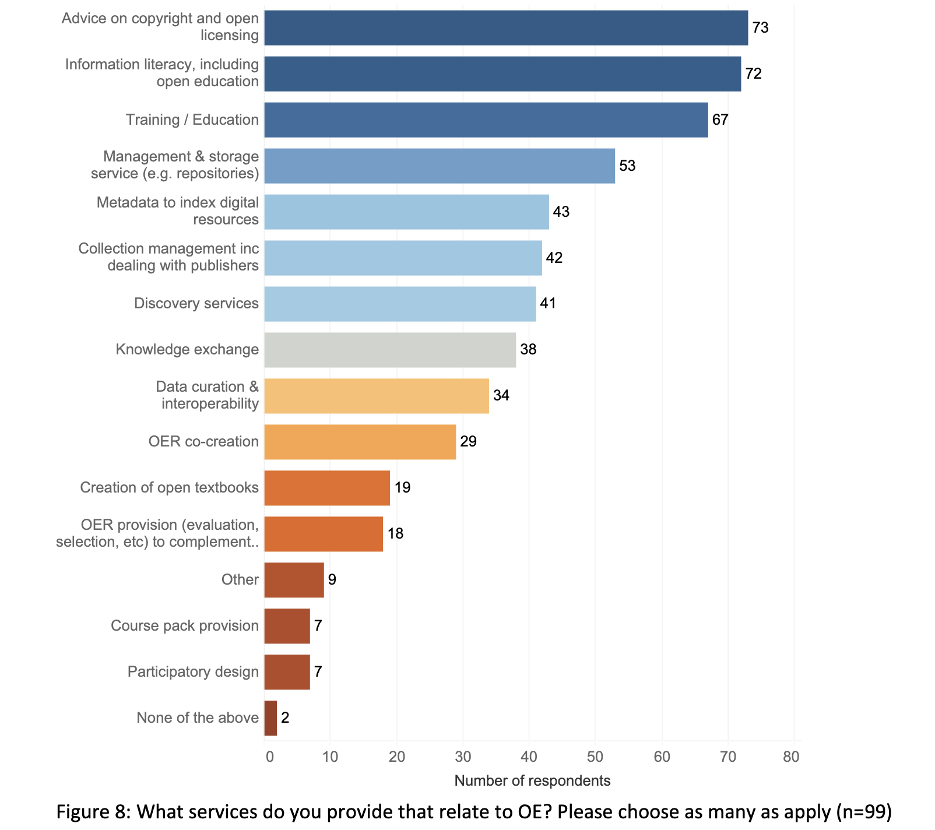
The role of libraries & librarians’ skillset
SPARC Report 2024:
116 respondents, including 8 swiss institutions
Libraries are central in supporting Open Education and Open Educational Resources, particularly by providing advice on copyright, open licensing, information literacy, and training for educators.
Challenges include resource constraints like funding and staffing, as well as uncertainties around legal aspects.
Treadway et al, 2024

Slide 22
Potential roles and services
OER discovery
Referencing, checking metadata
Training and support
Provision of a repository
Advocacy and OER embassy
OER co-creation and project curation

Slide 23
1. OER discovery
Skills :
Challenges
Search skills and needs differ for OER creators, teachers and students : tailor support
Multiple repos / catalogs, various types of contents : lack of standardisation
Source evaluation : new criterias ?

Slide 24
2. Reference and metadata
Skills :
Challenges
Where to start ?
Contents created outside the org that are valuable for learners ?
Find contents created within the institution but not referenced
Where to include it ?
Library catalog
Dedicated repo
Somewhere else (i.e. Zenodo)

Slide 25
3. Training and support
Skills :
- Habit of training students and researchers
- Lots of knowledge regarding content: copyright, Creative commons licences, and sharing formats
Challenges
New material to create (or use OER)
Reframe previous expertise
Collaborate with others stakeholders

Slide 26
4. Repository provision
Skills :
- Long tradition of provision information systems (repositories, library catalogs)
Challenges
Funding
Re-inventing the wheel or joining something existing
User adoption

Slide 27
5. Advocacy and OER embassy
Advocacy within the institution to promote OER as part of Open Science
OER embassy : position the library as a place to ask about OER, create OER, share OER, etc. (whether this position is officially attributed by the institution or if it is ‘de facto’)
Skills :
Challenges
OER are becoming «trendy» (association with digital skills within the latest PgB, association with generative AI)
OER are sometimes assimilated to MOOCs
Considerations around teaching

Slide 28
6. OER co-creation and OER project (co-curation)
OER co-creation : being actively involved in the creation process of OER
OER project curation : select, fund, coordinate for OER creation projects (example follows)
Skills :
Challenges
For this role, libraries need to be at the forefront of OER within the institution
It is a new role for most libraries to be involved as content editors
Potentially managing funds and allocating resources
28

Slide 29
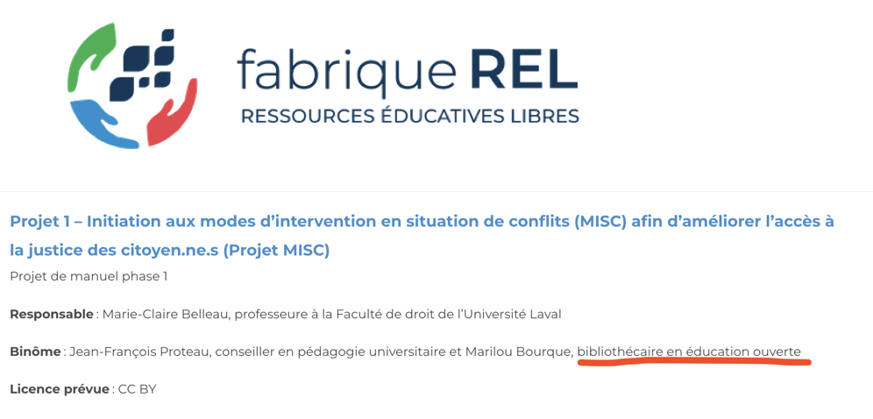
Support for OER creation and project curation

Slide 30
Pooling expertise in repository management (Repository provision)
Requirements / need
Platform for teachers to exchange teaching materials
Clear licences (Creative Commons)
Easy search and discovery thanks to metadata
Low cost per higher ed institution // scaling up
Solution
Central OER entry point for higher education institutions
Pilot project underway since November 2023
oer.switch.ch

Slide 31
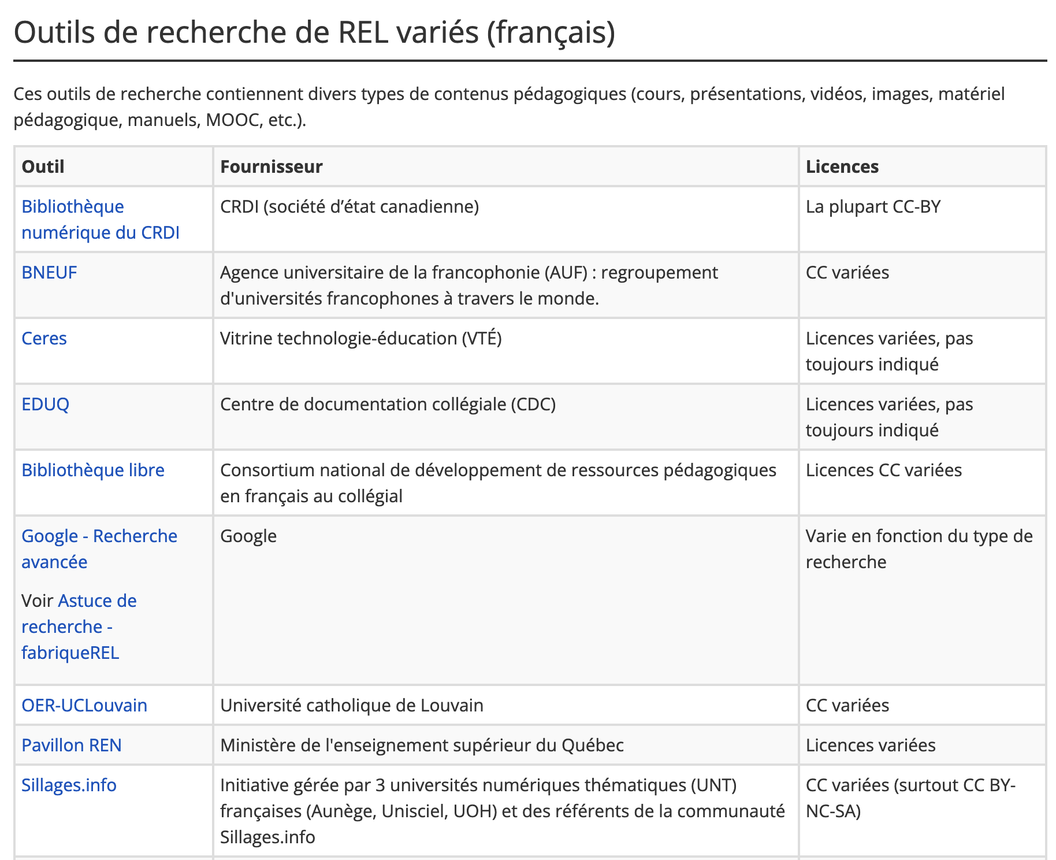
OER repository selection (OER discovery)
https://bib.umontreal.ca/guides/types-documents/rel

Slide 32
Take away message
Libraries are in a unique position, as third places in higher education institutions, to host reflexions on Openness
Guarantee critical thinking
Guarantee a deontology oriented towards the common good
Guarantee freedoms to users towards learning, exchange and creativity
Libraries have the skills and knowledge of Openness in their DNA…

Slide 33
Looking forward to your reactions!

Slide 34
References (part II)
BIBLIOTHÈQUES - UNIVERSITÉ DE MONTRÉAL, [sans date]. Ressources éducatives libres (REL). Bibliothèques - Université de Montréal [en ligne]. [Consulté le 25 septembre 2024]. Disponible à l’adresse : https://bib.umontreal.ca/guides/types-documents/rel
FABRIQUE REL, 2020. Le parcours de création. [en ligne]. 2020. [Consulté le 25 septembre 2024]. Disponible à l’adresse : https://fabriquerel.org/processus-de-creation/
TREADWAY, Jon, CORTI, Paola et PROUDMAN, Vanessa, 2024. Open Education in European Libraries of Higher Education 2023 [en ligne]. Zenodo. [Consulté le 20 septembre 2024]. Disponible à l’adresse : https://zenodo.org/records/10889503
UNESCO, 2023. Open Educational Resources. [en ligne]. 2023. [Consulté le 22 septembre 2024]. Disponible à l’adresse : https://www.unesco.org/en/open-educational-resources

