Slide 1

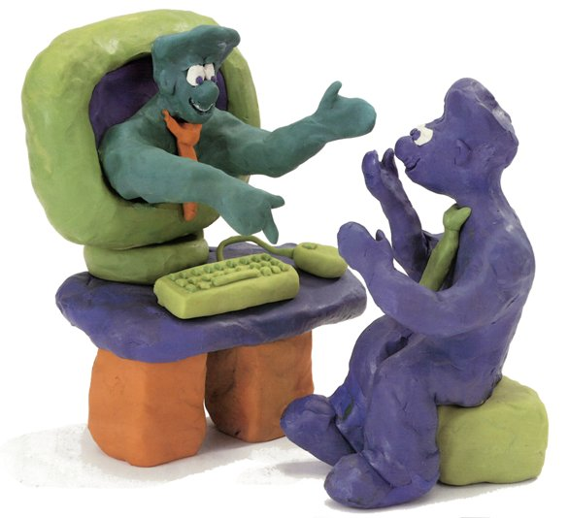

E-learning –
A troyan horse for change?
Daniel K. Schneider
TECFA – FPSE - Université de Genève
daniel.schneider@unige.ch
http://tecfa.unige.ch/DKS
“UNBORDERING” EDUCATION Forum
Yerevan, Sunday, November 2, 2014

Slide 2
What is e-learning ?
1.

Slide 3
E-learning includes:
Online course management
Knowledge creation
Collaboration & Online tutoring
Electronic books
e-Learning
Automated assessment
Interactive multimedia
Teleteaching through videos
Simulations and educational games
… and much more

Slide 4
E-learning is:
Digital education
Technology-enhanced learning
Other words to talk about the same subjet …
ICT in education
Learning with technology
Academic fields of research & study
Instructional technology
Educational technology

Slide 5
E-learning is many things (again):
Cognitive tools for learning, computer-assisted language learning, computer-based assessment systems, computer-based training, computer-mediated communications, computer-supported collaborative learning, distributed learning environments, electronic performance support systems, interactive learning environments, interactive multimedia systems, interactive simulations and games, intelligent agents on the Internet, intelligent tutoring systems, microworlds, virtual reality based learning systems, MOOCs, ….
Dozens of educational strategies
Dozens of technologies

Slide 6
E-learning example #1:
After-school learning for kids:
Self-paced
Based on individual preferences
Within that flexible framework, kids can learn in four areas:
Computer animation
Game Development
Web Development
Digital Media
The design:
Kids use Tumo World, a virtual learning world
… a virtual territory, where each kids’s avatar explores a landscape of learning.
Places hold learning activities.
Each personal learning trajectory is illustrated with a visual evolving path.
Kids also interact with each other, exchange notes, form teams, etc.
Progress is like in games. , Members collect skill units and gain access to new online activities and physical workshops.
Where is this e-learning located ?

Slide 7
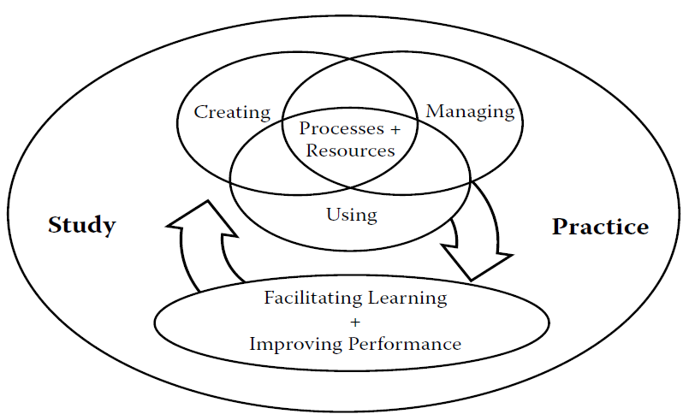
e-learning wants to improve education through technology
… and educational technologists are key actors …
Educational technology is the study and ethical practice of facilitating learning and improving performance by creating, using, and managing appropriate technological processes and resources.
(Association for Educational Communications and Technology)

Slide 8


E-learning example #2:
Learners:
Study online materials, including multimedia
Exchange in forums
Complete practical assigments
Do online quizzes
Participate in some face to face meetings and visits
Offred by: KASA Foundation Target population: people who want to be a guide in the tourism sector.
Modules: 19
Workload: 7-9 hours/week (online/offline)
Duration: 6 months
Language: Armenian
Certification: Issued by KASA
Price: 20.000 AMD monthly

Slide 9
There is change:
More learning outside school
Now, is there pedagogical change in formal education ?

Slide 10
The role & evolution of technology
2.

Slide 11
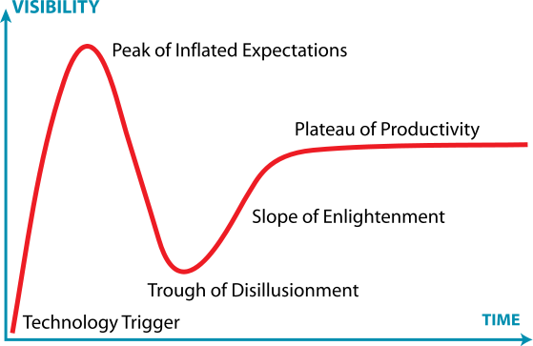
E-learning = A history of (mostly) aborted hype cycles
The Hype Cycle is a branded graphical tool by Gartner Consulting for representing the maturity, adoption and social application of specific technologies.
2 - 25 years
http://en.wikipedia.org/wiki/Hype_cycle
Technology, not pedagogy, triggers new cycles

Slide 12
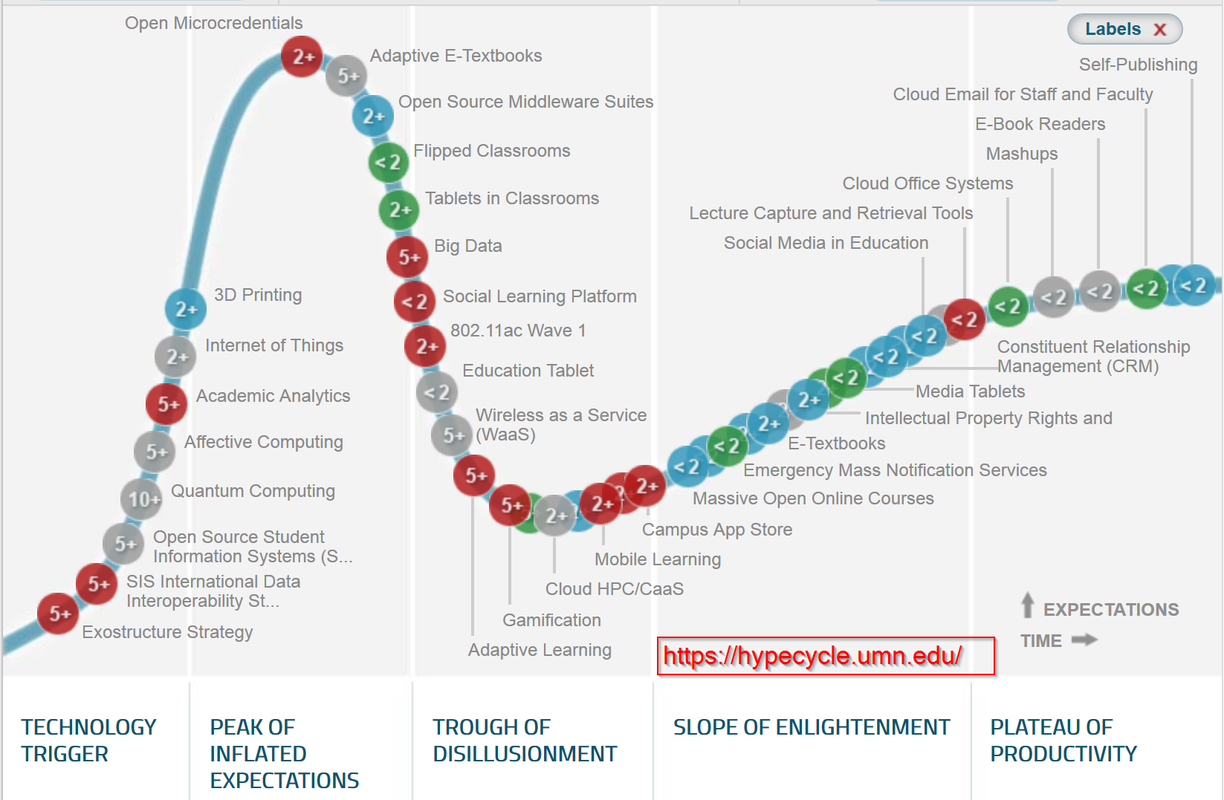
The technology hype curve in education (2014)
Interactive tool: https://hypecycle.umn.edu/

Slide 13
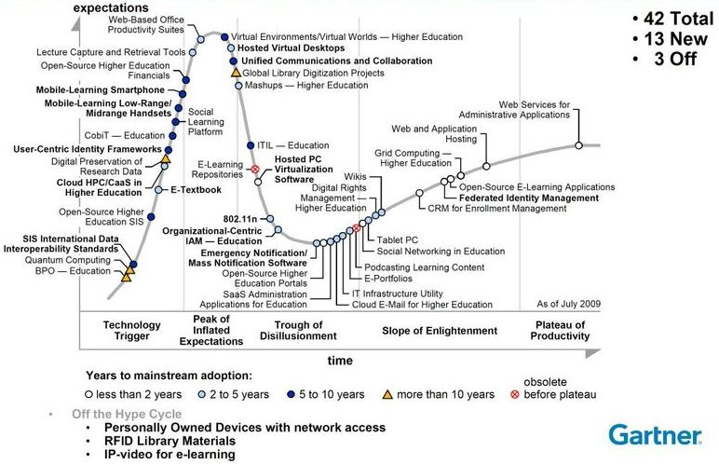
It is difficult to predict the future
2009:
Gartner’s education hype cycle: Educational TV is dead
But in 2014:
Podcasts are central
in (x)MOOCs !

Slide 14
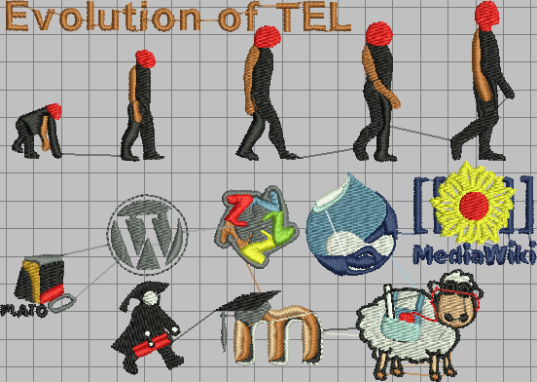
Evolution of the e-learning infrastructure
Avoid catching up with the latest hype: Invest time in instructional design and understanding past achievements
(1) production
& sharing
(2) control
(3) others, e.g. social tools
1964
1996
2000 -

Slide 15
E-learning - A slow history of innovation & change
«Big inventions» about every 10 years
  New administrative structures are created, no communication
  New people enter the game, no understanding of basic principles
Virtual
Env. I
Non-edu
tools
A huge diversity
Virtual
Env. II
OER
Analytics
MOOCs
Computer-
based
training
CBL,
micro-worlds
simulations
E-learning
platforms
TV
Intelligent
tutoring
Edu
games
CSCL
1960
1970
1980
1990
2000
2010
2015

Slide 16
Change is usually very slow, sometimes it appears to be fast
The xMOOCs «tsunami» bundles other stuff…
Open educational resources (OER)
Educational broadcast
(Edison ‘20)
Podcasts (iTunes)
Teleteaching
Educational TV
Khan academy
(cool videos for kids)
Computer quizzing
(automate assessment)
xMOOCs
Rapid e-learning
(short videos for grown.ups)
Peer-to-peer assessment
Collaborative learning
cMOOCs
(Downes & Siemens)
Online communities
1920
2008
2012

Slide 17
What is education ?
3.

Slide 18
First principles: what is good education ?
Connect & apply
The demonstration principle
  Learning is promoted when learners observe a demonstration
The application principle
  Learning is promoted when learners apply the new knowledge
The activation principle
  Learning is promoted when learners activate prior knowledge or experience
The integration principle:
  Learning is promoted when learners integrate their new knowledge into their everyday world
The task-centered principle
  Learning is promoted when learners engage in tasks that lead to something
  http://mdavidmerrill.com/Papers/firstprinciplesbymerrill.pdf

Slide 19
The e-learning challenge
N participants
Find good strategies and tactics to achieve quality
100’000
Videos
?
xMOOCs
10000
?
TextBooks
Distance
E-learning
with quizzes
Dist. elearning
with activites
& tutoring
?
1000
Teacher-led
E-learning
with activities
?
100
Blended
learning
?
Classroom
learning
?
10
low
high
Richness
& quality

Slide 20
Answering the e-learning challenge
Invest in instructional design:
Strategies
Tactics
Think
Discuss
Create learning scenarios
(evaluate and redesign)
Respect diversity (both educational & cultural)

Slide 21
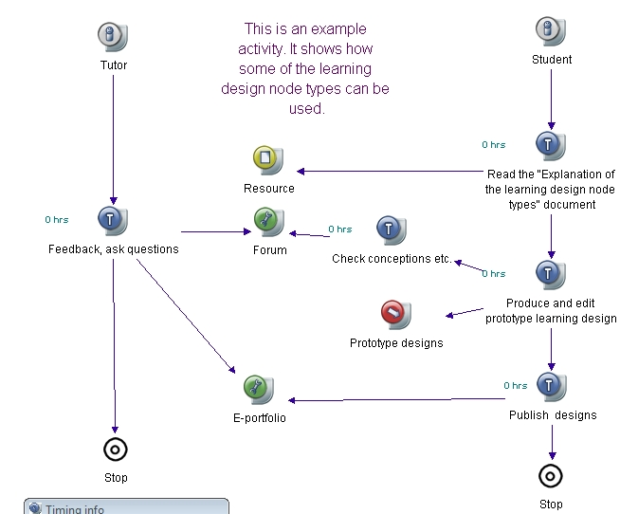
Educational scenarios
Strategies & tactics
made operational
Who does what and when,
using tools and resources
… also called «learning designs»

Slide 22
Strategies and technology must fit learning types and goals

Slide 23
Example: A strategy for facts and simple procedure learning
9 events of instruction (Gagné)
Gain attention (ground the lesson, motivate)
  Present a good problem, a new situation, use a multimedia advertisement, ask questions…
Describe the goal (frame the information, create expectancies)
  State what will be accomplished, how knowledge can be used, give a demonstration,...
Stimulate recall of prior knowledge (help connecting)
  … facts, rules, procedures or skills relevant to the current lesson ….
Present the material to be learned
  e.g. text, graphics, simulations, figures, pictures, sound, etc. Chunk information
Provide guidance for learning
  Presentation of content is different from instructions on how to learn. Use of different channel (e.g. side-boxes)
Elicit performance "practice"
  Let the learner do something with the knowledge, practice skills or apply knowledge. At least use MCQ's.
Provide informative feedback ,
  show correctness of the trainee's response, analyze learner's behavior, maybe present a good (step-by-step) solution of the problem
Assess performance, test if the lesson has been learned.
  Also provide general progress information
Enhance retention and transfer :
  e.g. inform the learner about similar problem situations, provide additional practice. Put the learner in a transfer situation...

Slide 24
Exemple: Project-oriented learning → principles
External resources
Read
Learning
materials
Discuss
The learning-by-producing cycle
Learner
Productions
Produce/
write
Learning
Includes:
inquiry-based learning (IBL)
problem-based learning (PrBL)
project-based learning (PBL)
project-methodology-based learning
case-based learning (CBL)
…….

Slide 25
Project-oriented learning requires learning design (story boarding)
Ex.: Inquiry Based Learning design
Elicit questions
Experiment, observe,
read.
Compose Q & A
Present / Discuss
Reframe
The crucial difference between current formulations of inquiry and the traditional "scientific method" is the explicit recognition that inquiry is cyclic and nonlinear.»
  Sandoval 2004p. 216
http://tecfa.unige.ch/perso/lombardf/publications/maastrich-14-16XI07/

Slide 26
Some strategies take time- Inquiry-based learning (Lombard, 2012)
It takes about 3 month before there is some deep learning !!
22.4%
34.1%
30.5%
13.0%
Notes:
1 groupe de 4 élèves
233 items

Slide 27
Back to tools
Activities are supported by tools and should lead to “products”
+ Coordination / management tools
Scenario 1
Project &
intermediary
Products
Activity 1
Activity 2
Tool 1
Product 1
Activity 3
Tool 2
Product 2
Scenario 2
Activity 4
Product 3
Tool 3
Activity ..
(News engine, blog, wiki, file upload, links manager, albums, glossary tool, calendar, forum,
IM, project mgmt, databases, professional software, …)
02.11.2014
27

Slide 28
Good e-learning:
….. uses an appropriate pedagogical strategy
aligned with goals, means and other constraints
….. creates active learning and active learners
Good e-learning technology:
Supports planned (and unplanned) tactics
with appropriate tools

Slide 29
Do we have good data about educational strategies ?
5.

Slide 30
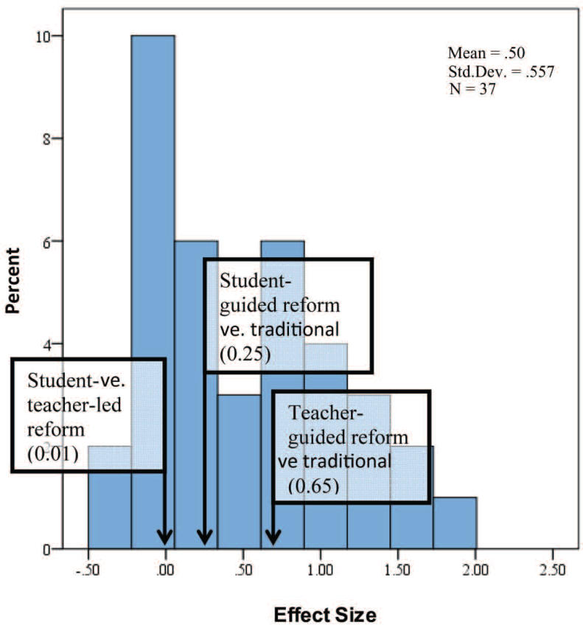
Meta studies (studies about studies)
In a review of literature, we identified 300+ articles whose descriptions related to video games and academic achievement. We found some evidence for the effects of video games on language learning, history, and physical education (specifically exergames), but little support for the academic value of video games in science and math. (Young et al., 2012)
After a half-century of advocacy associated with instruction using minimal guidance, it appears that there is no body of research supporting the technique. In so far as there is any evidence from controlled studies, it almost uniformly supports direct, strong instructional guidance rather than constructivist-based minimal guidance during the instruction of novice to intermediate learners.
(Literature review, Kirschner et al., 2006)
Experimental and Quasi-Experimental Studies of Inquiry-Based Science Teaching : A Meta-Analysis, (Furtak et al. 2002): Teacher-guided inquiry works better than “open inquiry” or “traditional” pedagogy
Interesting, but meta studies do not control all variables …

Slide 31
The bottom line from many meta studies:
Learners need guidance
Ambitious strategies require “scripting”
Education is design for learning
Learners need (formal) challenge
Quality is more important than type of design
We can and must do evidence-based e-learning design,
but each gooddesign is a result of «art» created in and for a specific context.
Education science only can look at fragments, not the whole ….

Slide 32
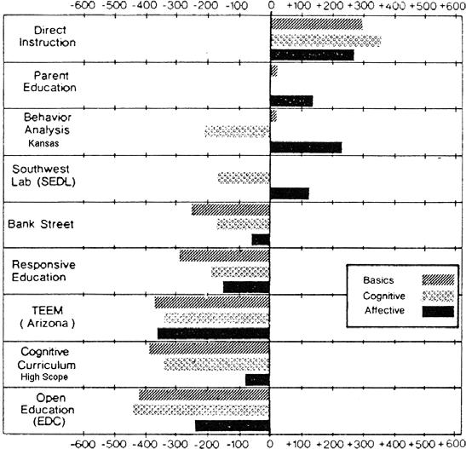
Large scale comparisons between techno-pedagogical designs ?
None, only indirect unreliable comparisons:
Scandinavian countries vs. others in PISA tests
1970’s “Follow Through” (disadvantaged primary school children) $600M implementation / $30M evaluation study:
Students from difficult backgrounds need simple structured pedagogy
Becker & Engelmann, 1980’s
Good practice seems to be contextual

Slide 33
E-learning = A chance for pedagogic change ?
5.

Slide 34
Innovation in schools ?
Burkhardt and Schoenfeld, Educational Researcher (2003)
Model 1: Teachers read research and implement it in their classrooms: teachers neither have time nor skills
Model 2: Summary guides: not explicit, not enough
Model 3: General professional development: Long-term professional development for teachers can be effective. (Briars, 2001; Briars & Resnick, 2000).
Model 4: The policy route: diagnosis of causes is speculative, uses not effective time scales, etc. (Dillon, 2003).
Model 5: The long route: takes 25 years or more: productive dialectic between educational research and practice.
Model 6: Design experiments: Work, but can’t be scaled
Time needed for school-wide change= 25 years or more

Slide 35
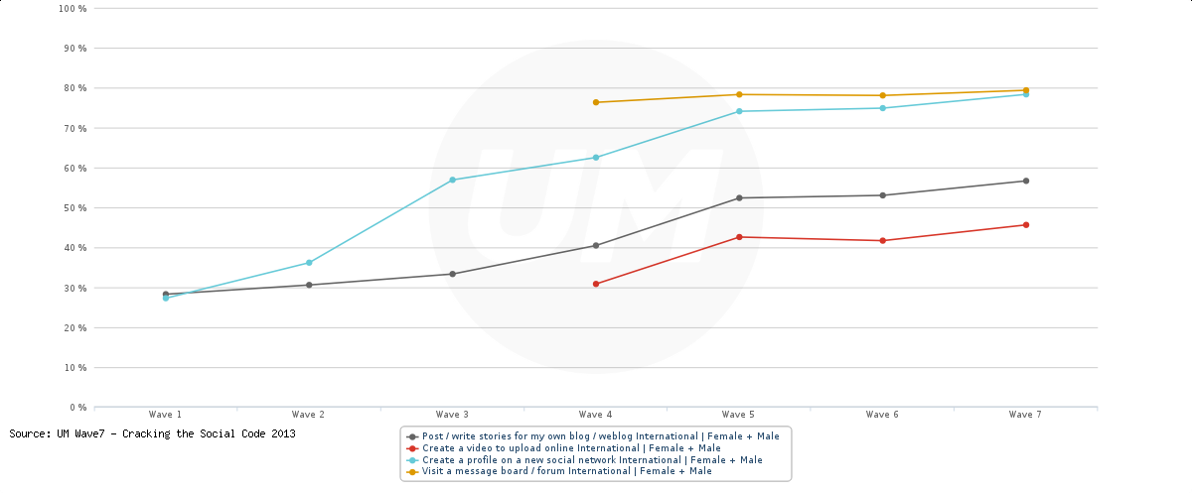
The Net generation (I)
Good News !
Penetration of active social tool use is on the rise (blog writing, video creation, profile create, visiting forums)
http://wave.umww.com/
However, …..

Slide 36
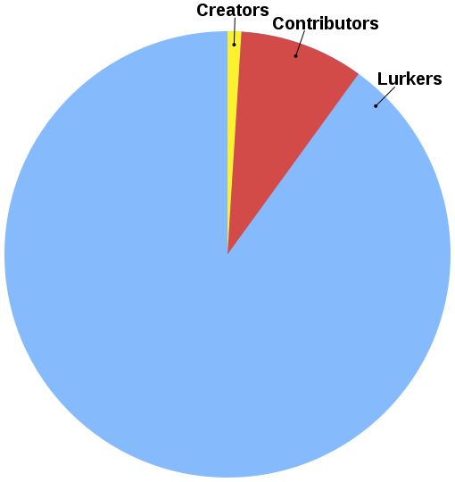
The Net generation (II)
1% Rule: Only 1% of a community web site’s users are active
Variants: 1-9-90 rule or 90–9–1 principle:
Within a community:
90% only view content,
9% edit content
1% actively create new content.
http://en.wikipedia.org/wiki/1%_rule_(Internet_culture)
Wikipedia statistics (feb 2014)
18 billion page views
500 million unique visitors each month.
22 million accounts
~70,000 active editors (0.01 %)
~7000 do half of the content (0.001 %)

Slide 37
The Net generation (III)
People can:
… engage in digital conversation
… create simple digital objects (messages, videos, posts, …)
… exchange digital objects
Internet skills are conversational
People cannot:
… use professional software
… participate in knowledge creation environments
… articulate scenarios
Full ICT and knowledge working skills must be taught
(some of it can be enforced in formal education !)

Slide 38
The Net generation (IV)
Today’s teacher trainers:
don’t know how to use technology
have a poor understanding of general pedagogy (instructional design)
E-learning is hard
Most young teachers cannot cope
Have to re-invent the whole wheel
Infrastructure is bad (even in Canada)
However
E-learning does work all over the planet
Many interesting creations

Slide 39
Conclusion
Change will only happen if there is a massif effort to:
discuss educational goals,
agree on a few fundamental principles,
identify means and strategies
allow teachers to learn
Intentions are not behaviors
Attitudes do not replace skills
Good education is expensive
Pedagogy is contextualized design
Troyan horses need people* inside
… and that’s the bottleneck !!!
*that means you

Slide 40
Thank you for listening
Questions ?
Comments ?

