Slide 1
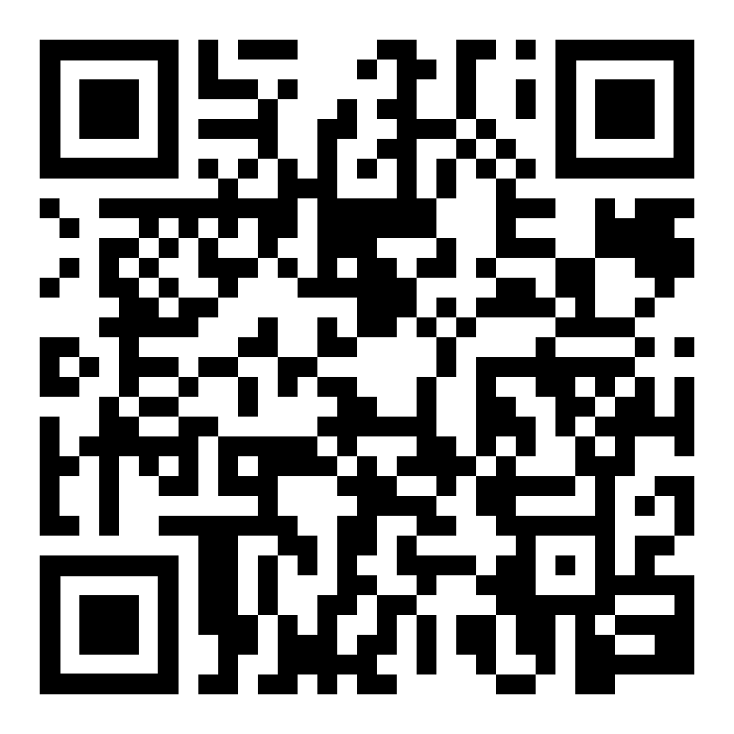

Computational Thinking and Making:
Computational Making invited talk
Connecting Technologies and Didactics - The IDEA Project Experience
Center for Advanced Studies Research and Development - CRS4
Thotel, Cagliari, February 10th to 11th 2020
Daniel K. Schneider
Associate professor of educational technology
Faculty of Psychology and Educational Sciences
University of Geneva
http://tecfa.unige.ch/DKS
http://edutechwiki.unige.ch/
https://tecfa.unige.ch/tecfa/talks/schneide/crs4-2020/

Slide 2
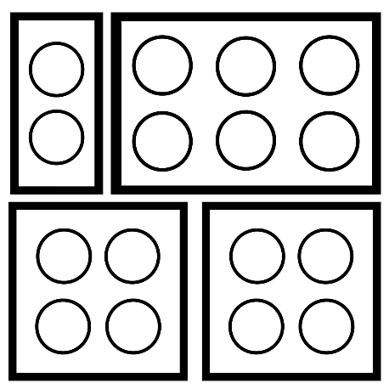

1. Context, definitions and objectives
https://tecfa.unige.ch/tecfa/talks/schneide/crs4-2020/

Slide 3
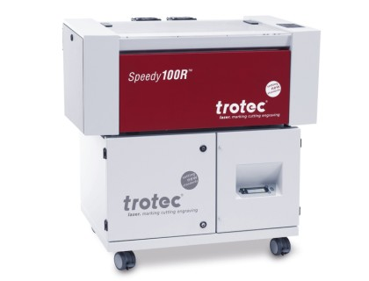
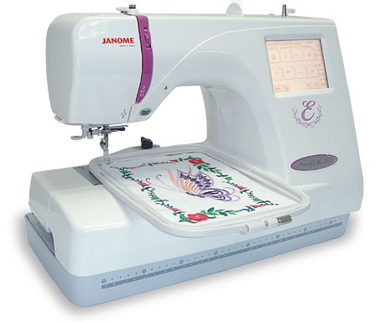
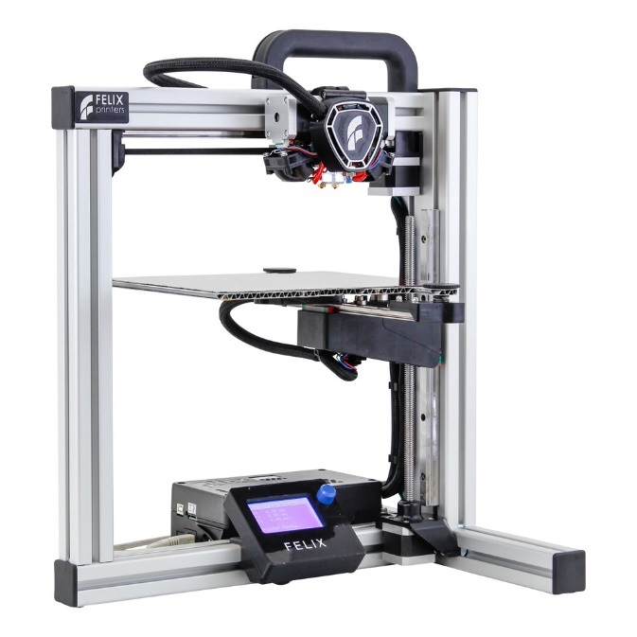
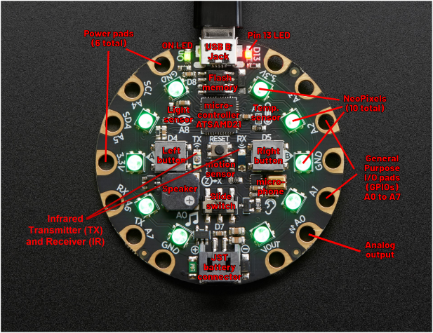
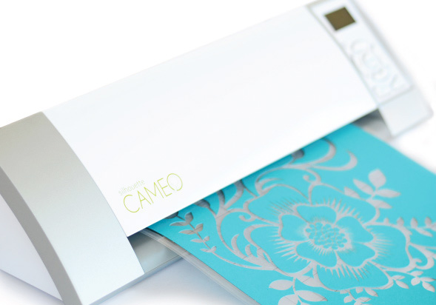
“Making” = Digital design and fabrication
Some end-user making technology:
Laser cutting:
Expensive hardware
Free or cheap software
Fast
Very noisy, smelly,
Computerized Embroidery:
Medium or expensive hardware
Very expensive or free software
Environment friendly
noisy
Electronic boards
Cheap hardware
Free software
require programming
Vinyl cutting
Very cheap hardware
Rather cheap software
Fast
3D printing
Cheap hardware
Free software
Very slow
Smelly
Gershenfeld (2005) «How to make almost anything » / Bowyer (2007) RepRap

Slide 4
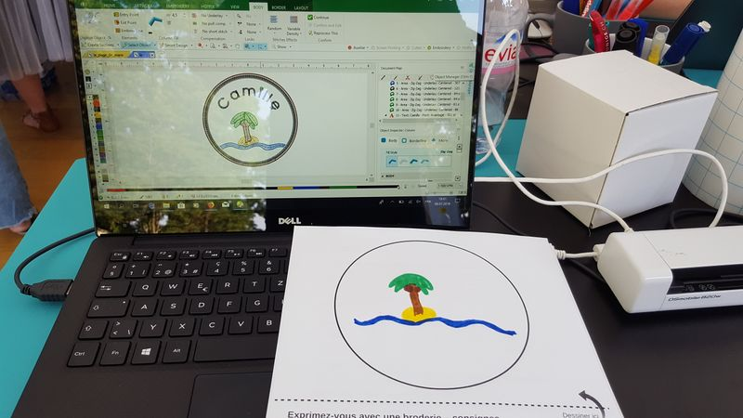

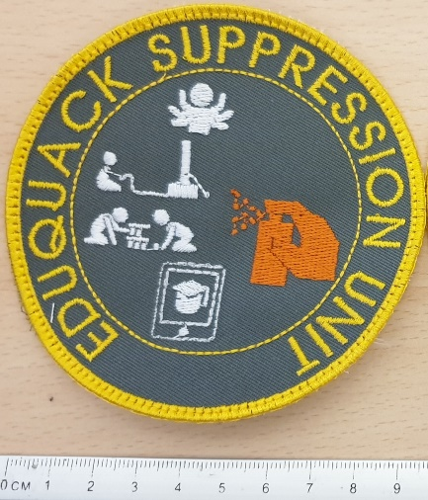
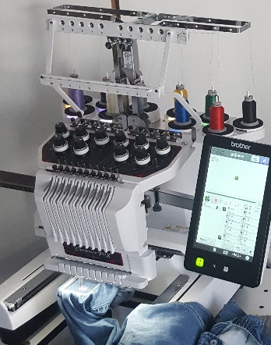
Workflow in making (simplified)
Idea
Draw or program a design
Parameterize/ Create machine file
A machine fabricates
Use

Slide 5
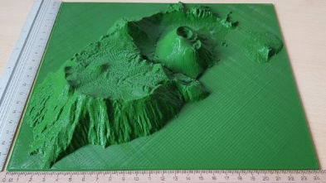
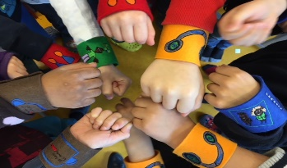
Making in education (1)
1
To enhance
a learning
activity, e.g. with a model
3D printing
For teaching
through
Laser cutting
Digital design and fabrication
2
Computerized embroidery
Learn by manipulating physical objects
Vinyl cutting
Electronic boards
3
For learning
Learn by creating objects
……..
For learning with

Slide 6
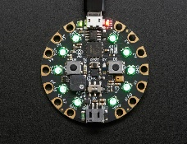
Making in education (2)
Skills
1
2
disciplinary
Teachers create learning objects
Learners use objects in a learning activity
transversal
digital design
3
Learners create objects and learn in the process
ICT literacy/
computational thinking
FOCUS OF
THIS TALK

Slide 7
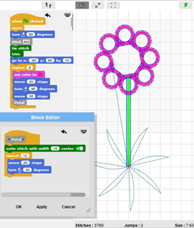
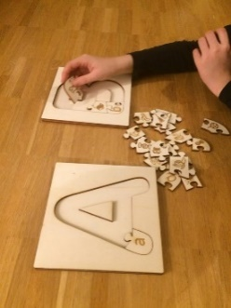
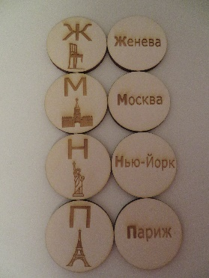
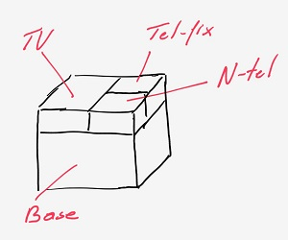
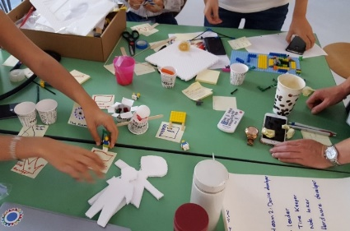
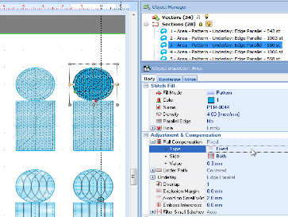
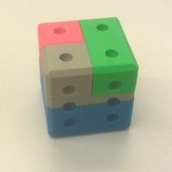
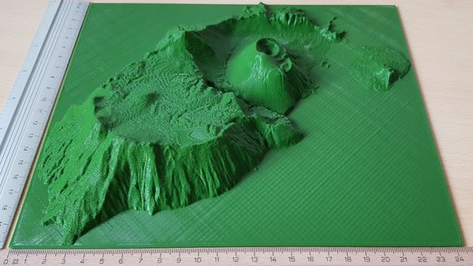
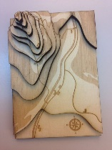

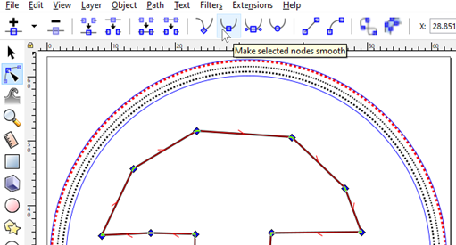
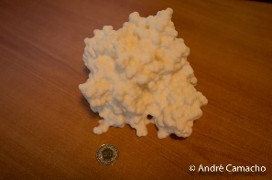
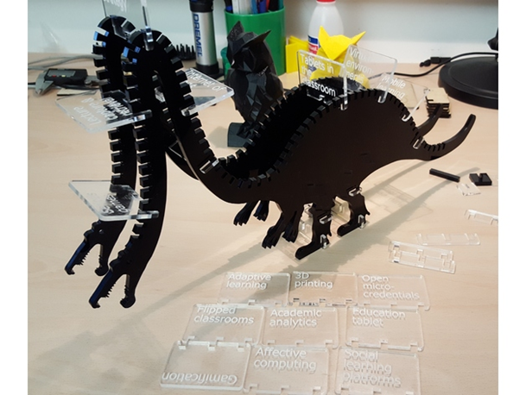
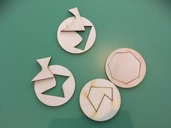
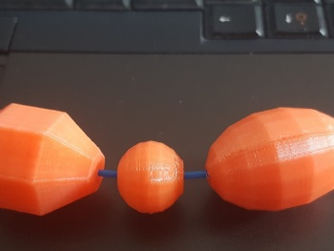
Computational thinking & literacy
Disciplinary skills
Transversal skills
Digital design
Languages
Programming
Doing projects collaboration
Parameterization
Science
Cultural competence
Technical drawing
Artistic physicalization
Maths
Use a system
Digicomp 2.0

Slide 8
Computational thinking
a set of knowledge, attitudes and skills that facilitate problem solving based on principles from computer science.
Computational thinking competence:
formulate a broader issue
solve a problem / create a solution using information and communication technologies*
share solutions
*using ICT:
decompose, abstract, define algorithm, identify forms, ……
find and install software, draw, manipulate images, parameterize…..

Slide 9
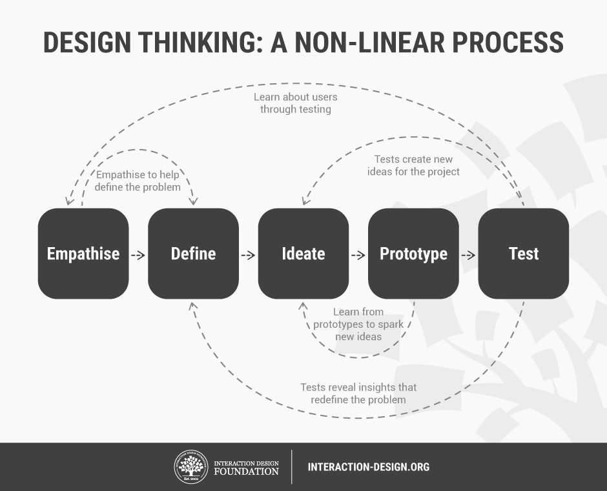
Both Making and Computational Thinking are related to Design Thinking
(some kind of user-centered design)
A dominant definition
from Stanford d.school

Slide 10
Computational making
Computational thinking
Digital design
Computer-controlled fabrication
Is essentially computational design,
affords high levels of precision,
automation of repetitive tasks,
adjust values while maintaining the constraints of the original model (parameterization).
Algorithms produce unique & unexpected designs.
Computational design = using programming to create and modify form, structure, and ornamentation (Jacobs and Buechley, 2013).
Computational making

Slide 11
Questions ?
Can we teach computational thinking (and other ICT skills) through making ?
What environments and activities work ?
Is it effective (and efficient) ?

Slide 12
2. theoretical foundations for learning with things
https://tecfa.unige.ch/tecfa/talks/schneide/crs4-2020/
Following the review of Zuckerman (2006) on constructivst learning objects

Slide 13
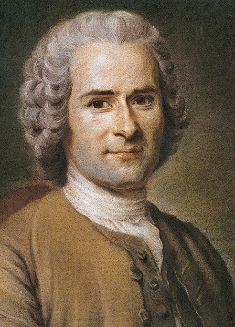
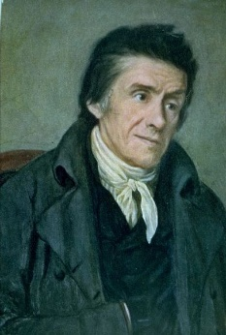
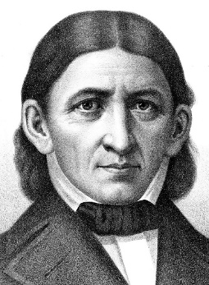
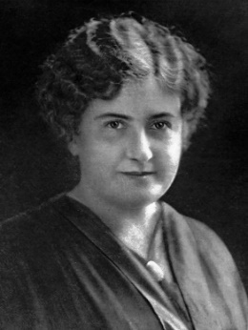
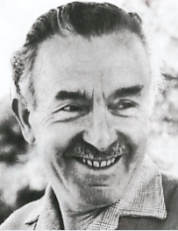
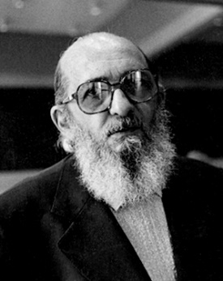
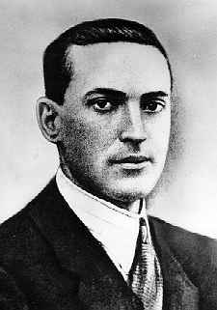
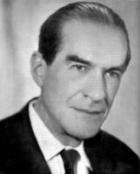
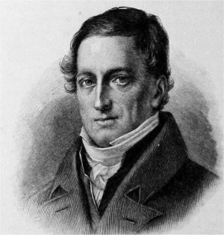
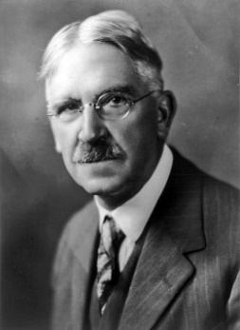
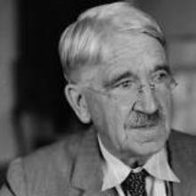
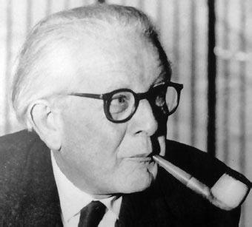
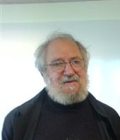
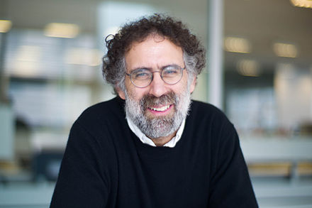

Slide 14
1. Learning by manipulating and constructing
Locke, 1632-1704
Sensory experience
Key idea: Promote learning through hands-on interaction with a “kit”
Rousseau, 1712-1788
Romanticism
Pestalozzi, 1746-1827
Learner autonomy and responsibility
“head, hand and heart”
Fröbel, 1782-1852
“Gifts” to experiment
A basic set of elements and operations
that can be combined (like words and sentences in a language).
Ready for exploration.
Montessori, 1870-1952
“Materials”
Piaget
Constructivism
Papert, 1928-2016
LOGO (1967)
Constructionism
Mindstorms (1980)
The construction kit:
Invites using it.
Is intuitive,
adaptable / flexible,
robust.
Create larger objects from small ones
Resnick, 1956,-
Lifelong Kindergarten
Scratch

Slide 15
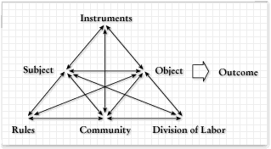
2. Activity-based learning
Key idea: Learning takes place in a social, cultural and material context
Karl Marx, 1818-1883
Pavlov, 1849-1936
Vygotski, 1896-1934
Socio-constructivism
Zone of proximal development
Leontief, 1903-1979
Activity theory (USSR)
Activity theory (Scandinavia)
Expansive learning
(Engeström, 1987)
Learning happens through reflection of social knowledge. Activities are:
focused on objects carrying culture;
mediated by tools carrying culture;
Socially organized
Activities are hierarchical: activity (needs, motivation), action (goal), operation (task);
Nardi, 1995 (use in HCI)

Slide 16
3. Hands-on, “real-world” projects
Fröbel
Herbart, 1776-1841
Key idea: Learning through interaction with the “real world”, doing projects with some learner autonomy.
Dewey, 1859-1952
Structured learning through experience
(hands-on, real-world projects)
Guided learner-centered pedagogy
Connecting subject matters to prior knowledge and experience
Kilpatrick, 1871-1965
Freinet, 1896-1966
Learner-centered inquiry-based learning
Collaborative work, creating products
Real-world experience (printing press, field trips, ….)
Responsibility of the child (participation)
Teacher as guide
Project-based learning
“hands-on”
Connect with real world
Freire, 1921-1997
Balance of action and reflection
Dialogue, creating autonomy
Respect of autonomy

Slide 17
4. Synthesis of theory
(found in the making & education community)
Project-oriented learning
(Dewey’s scaffolding)
Activity-based-learning
(cultural socio-constructivism)
Hands-on
micro-worlds
(Papert’s constructionism)
Learner autonomy and identity
(Freinet, Freire)
Neo-constructionism
Authentic
Identity-building
Structure
(learning design)
Hands-on

Slide 18
3. CompuTational making environments & THEORY
https://tecfa.unige.ch/tecfa/talks/schneide/crs4-2020/
A short synthesis

Slide 19
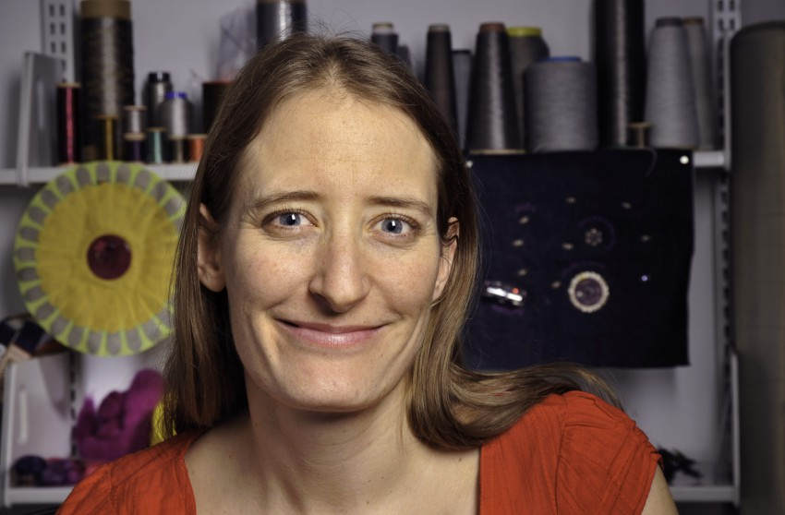

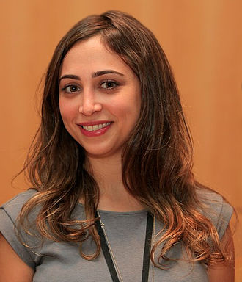
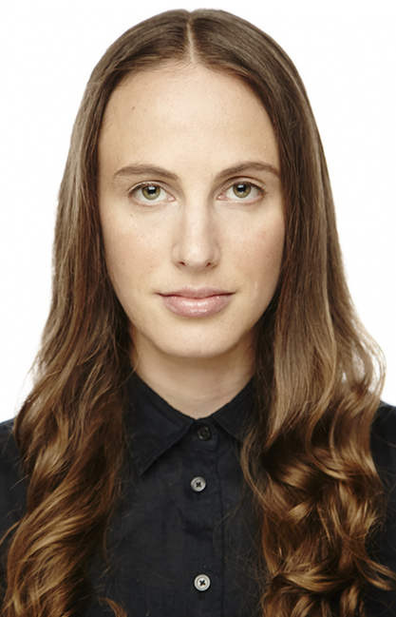


Leah Buechley,
Inventor, LilyPad
Computer science and making prof.
http://leahbuechley.com/
Ayah Bdeir
Founder, LittleBits
https://ayahbdeir.com/
Limor Fried
Founder and CEO, Adafruit
https://www.adafruit.com/about/
… and more
(including men)
Jennifer Jacobs
Computational fashion
and art professor
http://jenniferjacobs.mat.ucsb.edu/
Eva S. Katterfeldt
Computer science
education + making
Researcher
Kylie Peppler
Computer & education professor
Creative coding
http://kpeppler.com/
http://dimeb.informatik.uni-bremen.de/

Slide 20
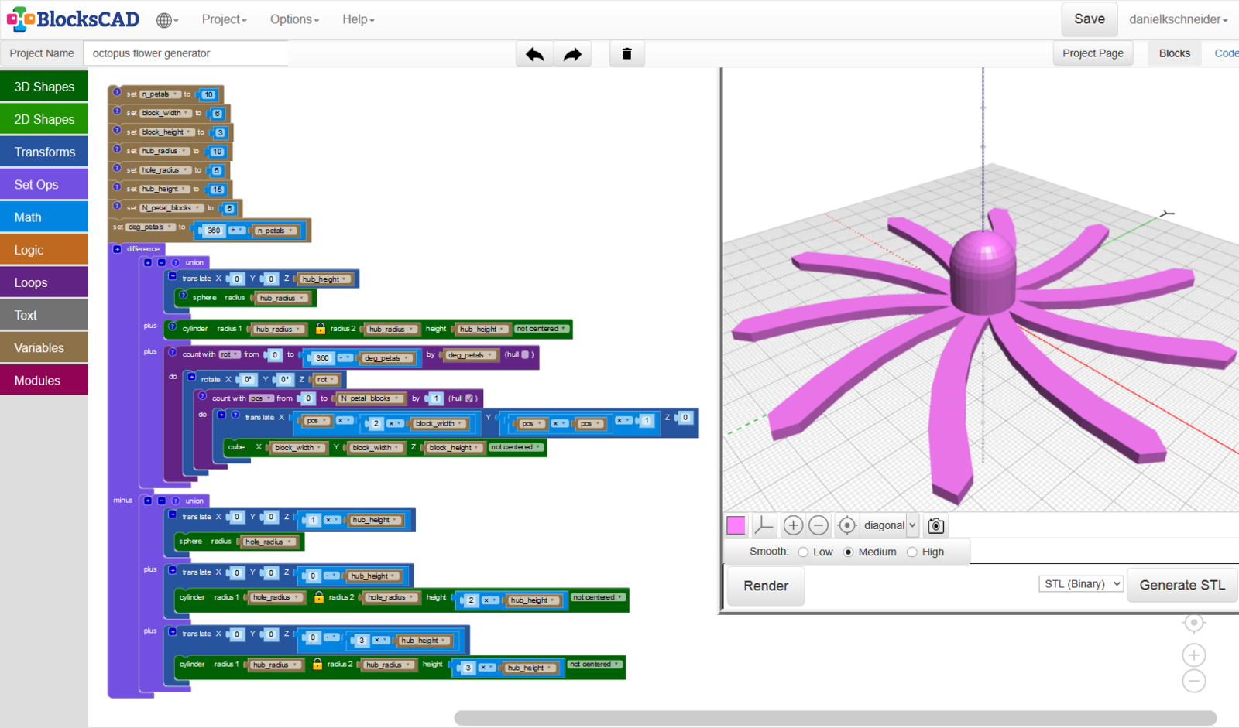
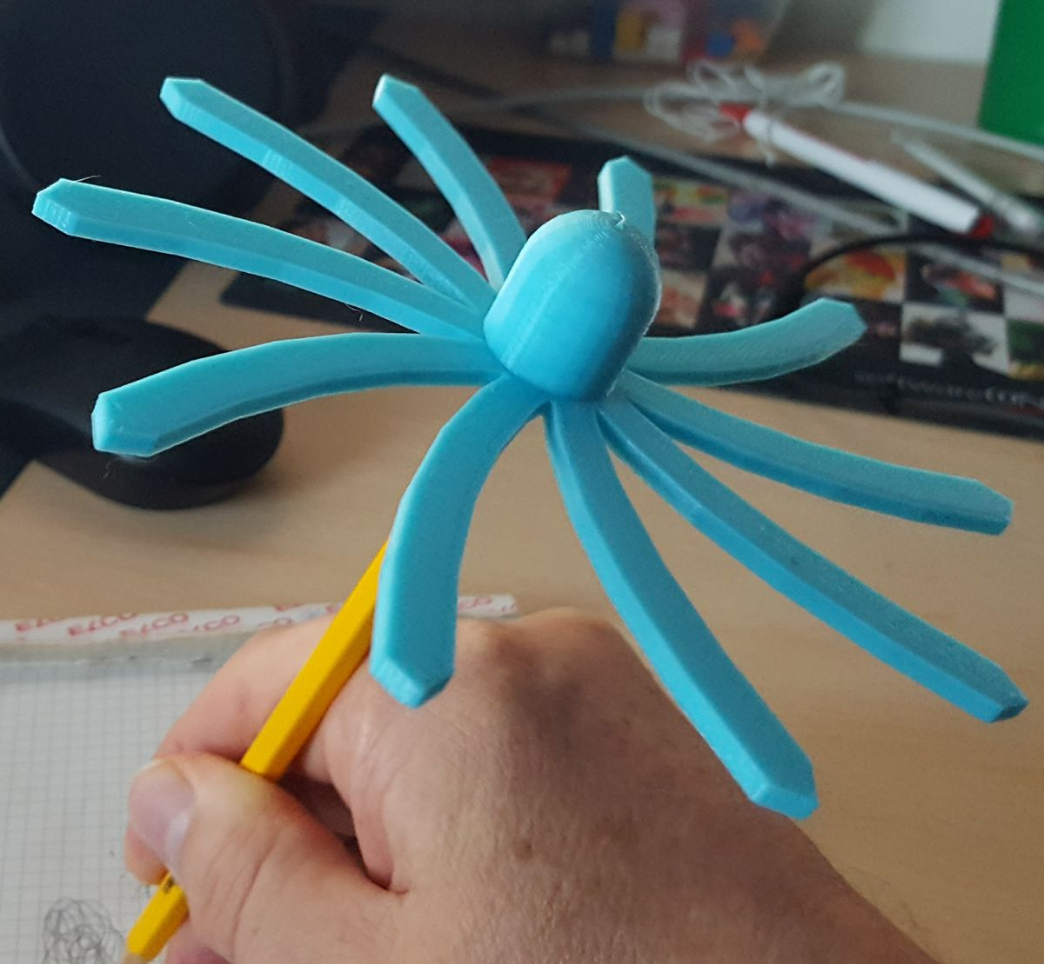
Programmed 3D objects - https://www.blockscad3d.com/
Computational making environment example
See also: https://www.tinkercad.com/learn/codeblocks

Slide 21
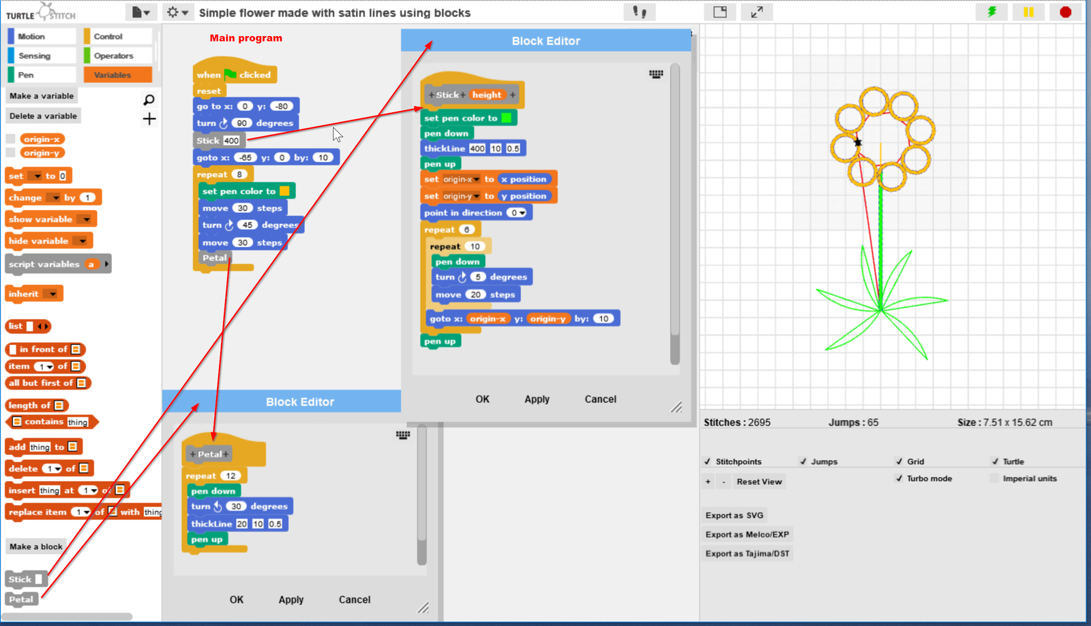
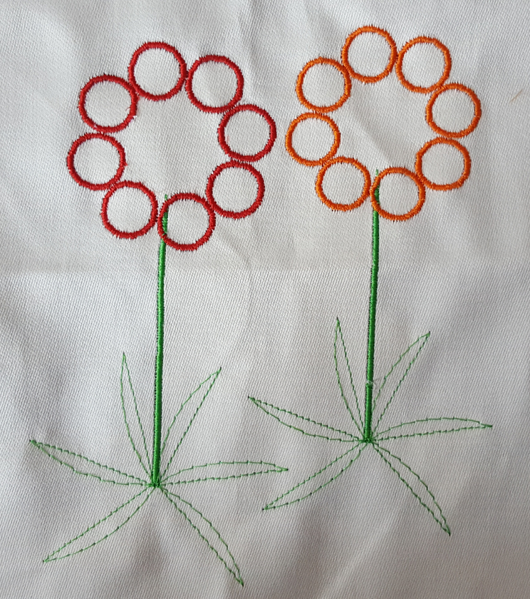
Coded embroidery - https://www.turtlestitch.org/
Computational making environment example

Slide 22

«Nodes» programming
http://nikitron.cc.ua/sverchok_en.html
Computational design environment example
Sverchok is a Blender extension that implements over 50 nodes. See also: Grasshopper, a Rhino extension
Image: https://poneill.co/thelab/%D1%81%D0%B2%D0%B5%D1%80%D1%87%D0%BE%D0%BA/

Slide 23





Digital Electronics – with Adafruit CPX https://makecode.adafruit.com/
Computational making environment example

Slide 24

Using the InkScape opensource drawing program + and its Ink/Stitch embroidery extension
Understanding file systems, drawing and parameterization
https://inkstitch.org/

Slide 25
Constructionist thoughts:
Features of digital making environments
Programming (computational making)
Visual languages include standard elements (Chitas et al, 2018),
export to symbolic languages.
Support for sharing code.
Direct creation of machine-usable formats.
Learning is favored:
by manipulation and discovery
by providing structure to activities
by inviting dialogue
Other ICT
System administration
Technical drawing
Image manipulation
Parameterization

Slide 26
So far, most research is theory building and UX testing
(an initial search produced about 50 publications)
Feelings of engagement and empowerment fostered by these experiences indicate that computational-design tools for novices could serve as a powerful way to positively change people’s understanding of the relevance and applications of programing, while fostering technological and aesthetic literacy in the process (Jacobs and Buechely, 2013)
The data shows that building the projects in our structured curriculum impacts builders’ technological self-efficacy, leading to in an increase in students’ comfort with, enjoyment of, and interest in programming and electronics. (Qiu et al. 2013)
motivation
Self-efficacy
The creation of computational artefacts as a means of expression could be an exciting way to develop computational literacy. (Chytax, Tsilingiris and Diethelm, 2019)
usefulness
«Bildung»
A school may purchase a 3D printer for educational purposes, only to have its student-makers print other people's models without learning to make their own. To prevent this kind of situation, educators must capitalize on the maker movement in ways that facilitate what we call computational making, which involves both meaningful cognition and the making of artifacts. (Johnson, 2017)
In addition to constructionism, the interaction between body and mind, creativity and technology and self and environment.”, i.e. be-greifbarkeit, imagineering and self-efficacy are essential requirements for learning environments for digital fabrication that facilitate Bildung (Katterfeldt and Dittert, 2015)
For the references, see: https://edutechwiki.unige.ch/en/Computational_making

Slide 27
4. Teacher-created Learning objects

Slide 28
Why «teacher making»?
Teachers who teach «making» must be trained or learn it themselves.
Creating objects for one’s own teaching is a good & motivating way to start “making” and in line with our neo-constructivist principles
2. To create educational objects that should should trigger cognitive and social processes that are good for learning
There is little research on the subject (Boufflers & Schneider, submitted)

Slide 29



Teach programming principles with unplugged programming
Example:
Programming Boty
Made with a laser cutter
map
Ojectives
Manipulate to learn abstract concepts:
instructions and procedures /calls
Programming supports
instructions

Slide 30








Communicate with children that have cognitive trouble
… and create/use many more kinds of teaching & learning tools
list of words
Learn about map topology
Project management with Lego and compatibles
Learn
letters
sentence
Isola di Vulcano, risk management
Large molecules and small drugs
Cox proteine
Drugs that fit
Tokens for classrooms
See also: http://tecfaetu.unige.ch/digifabwiki/index.php/Liste_des_projets

Slide 31



Early prototyping: engagement in thinking and collaboration with “common” manipulables can help shaping ideas, concepts and projects
90 min. workshop on defining roles for team work (including prototyping role tokens),
July 12, 2017, SDG Summer School, UniGE/Tsinghua

Slide 32
5. Conclusion and outlook

Slide 33
Digital design and manufacturing has the potential to improve pedagogies - including computational thinking - through (improved) authenticity, graspability, self-efficacy and structure
Some working hypothesis for further work:
Computational making environments allow teaching key components of computational thinking
The overhead of «making» is counterbalanced by other benefits, including motivation and self-efficacy.
Making favors integration of knowledge and authenticity
Making could develop 21st century soft-skills like design thinking, collaboration, and sharing
Digital manufacturing allow teachers to create objects that are useful (effective) and usable.
Design of physical tools leads to teachers to think educational activities in a different way.
Computational making can attract different populations to ICT

Slide 34
Thank you for listening
Questions ?
Comments ?
Your own work / experience ?
Slides:
https://tecfa.unige.ch/tecfa/talks/schneide/crs4-2020/
My preparation materials in our wiki:
https://edutechwiki.unige.ch/en/Computational_making
https://edutechwiki.unige.ch/fr/CFAO

