Slide 1
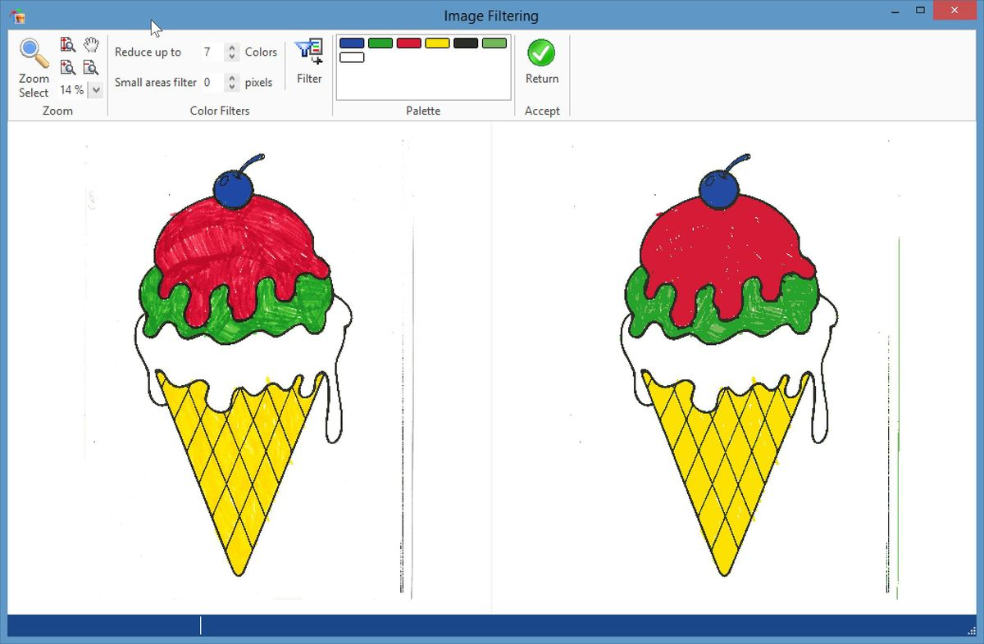
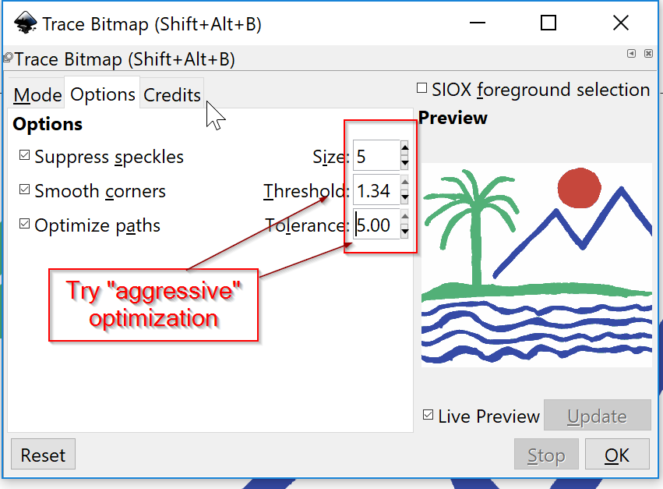
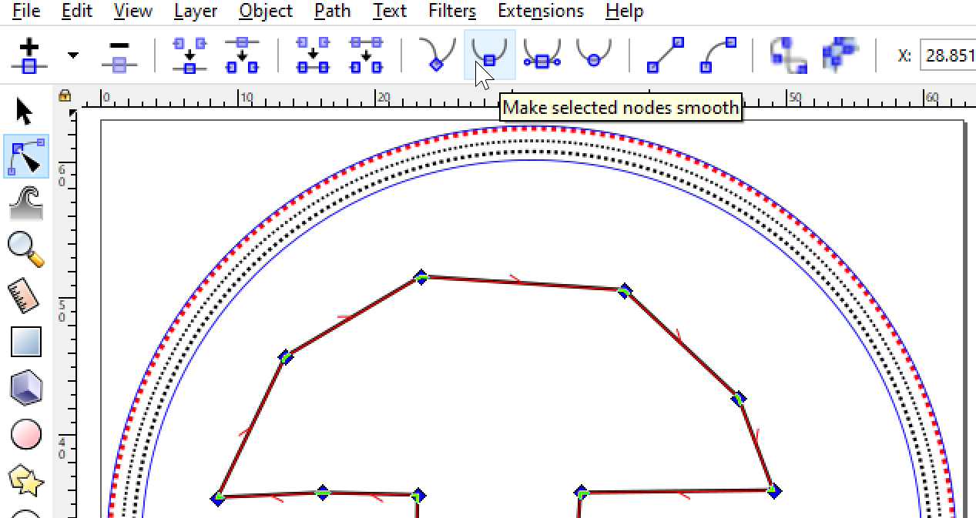
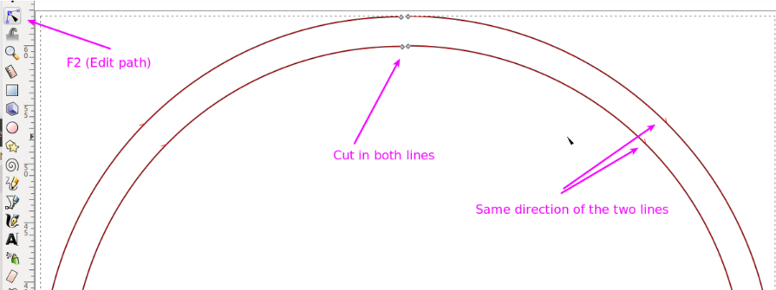
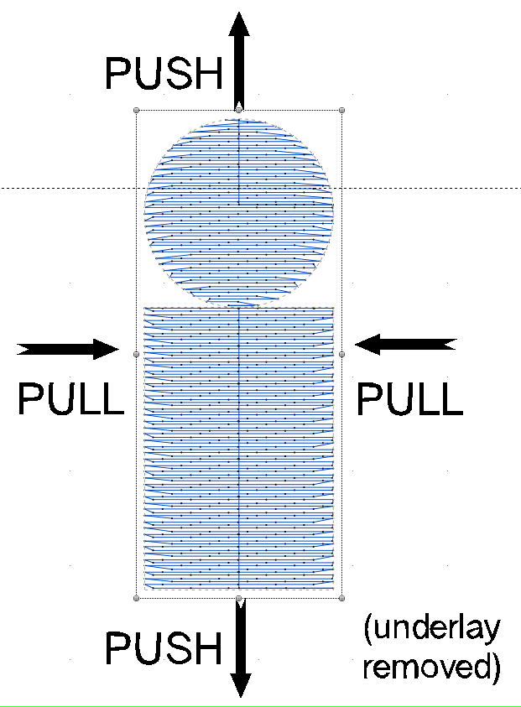
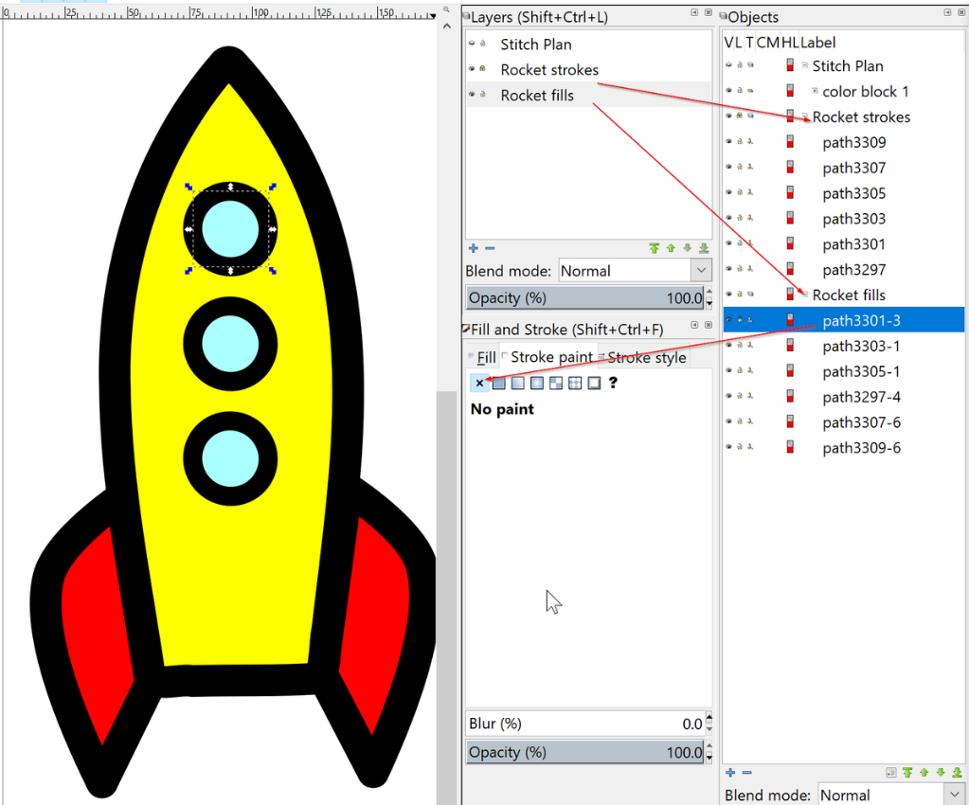
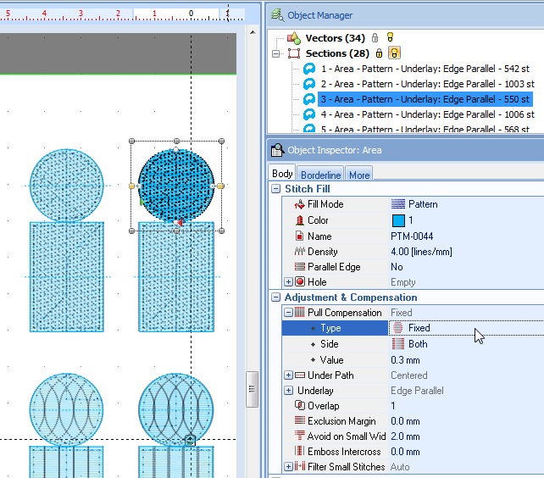
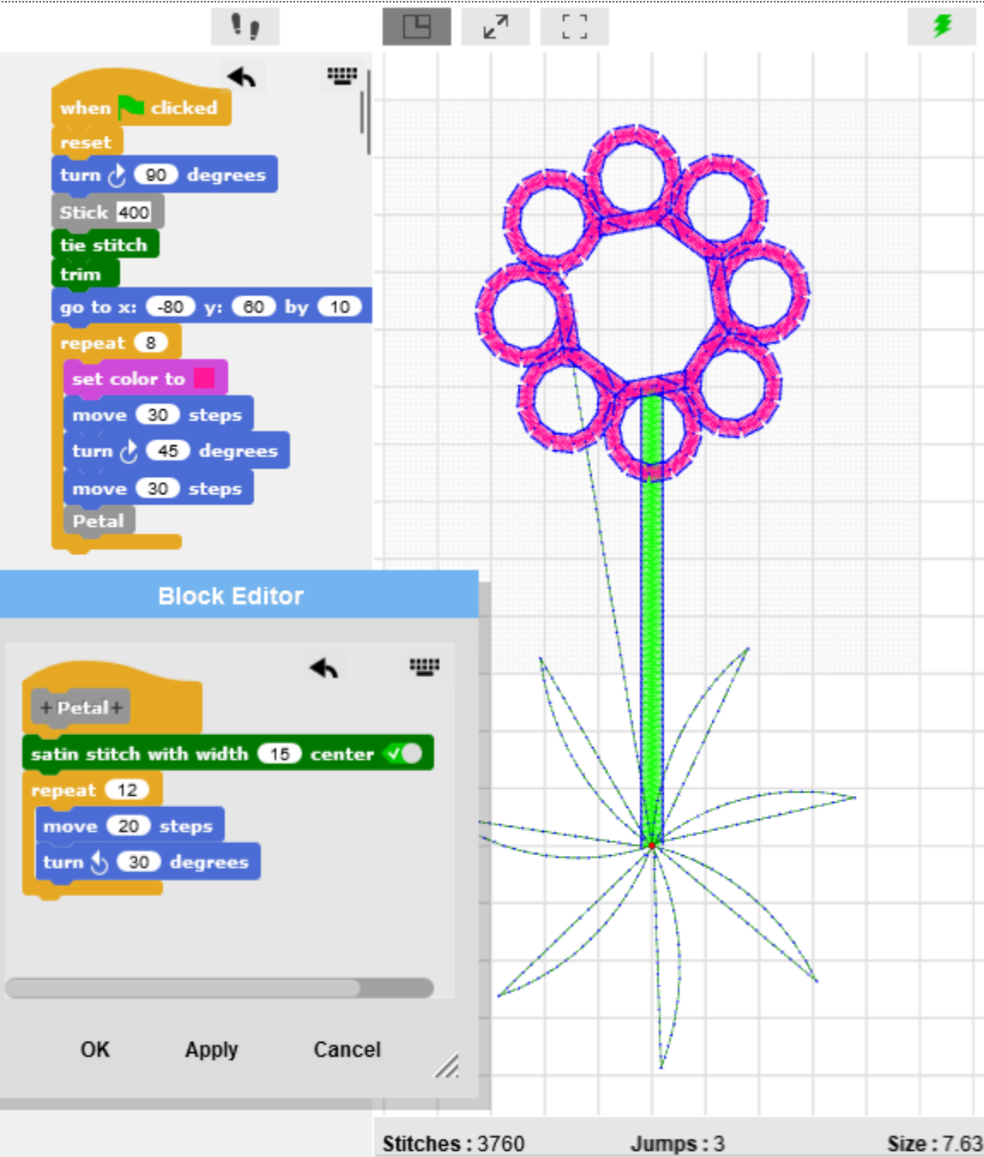
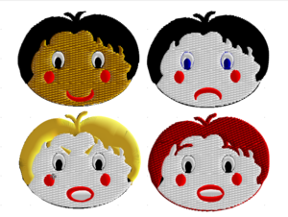
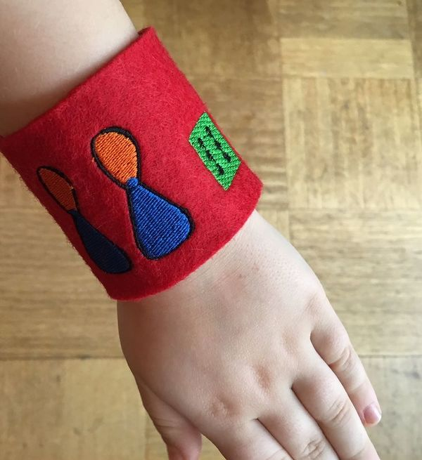
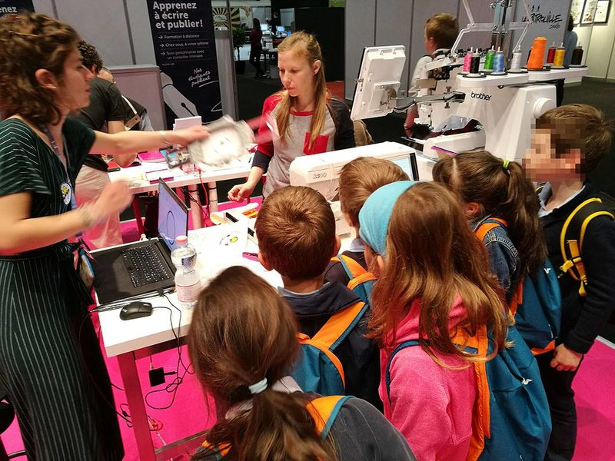
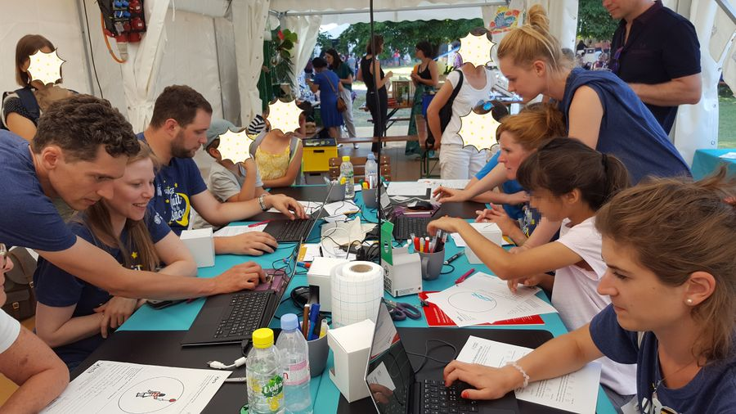
Digital embroidery to teach ICT skills
Design ideas
Raster images have to be simplified to be vectorized. E.g,. color reduction, change contrast, remove specks are useful skills for other contexts.
Vectorizing/tracing skills are useful in many domains.
program
Use digitized
letters
Draw vector objects
Hand drawing
Image manipulation
find
Objectives:
Contribute to ICT education and valorize digital embroidery as subject to be taught in both making and ICT classes
Digital embroidery allows learning vector drawing, programming, image manipulation, using complex software and general making skills.
Draw
Embroidery objects
Vector clip art
Scan & import
draw
Vector graphics
(drawing software)
Raster image (JPG, PNG)
Imported or created vector “paths” must be reshaped, broken, glued, etc. This encourages learning advanced functionally of a vector drawing program or a vector drawing module.
Contrast, reduce colors, …
Vector manipulation
Results:
Six small and large-scale successful outreach events
Positive results in a satisfaction and apprehension survey: A questionnaire administered to 78 participants (M_age=18.10, SD_age=14.18, 47% F) at one event measured interest and perceived difficulty. Interest in the activity was high (on a scale of 1 to 7, M=6.91, SD=0.29). In pre-post comparison, participants have a stable image of the difficulty of drawing and vectorization but reevaluate downwards the difficulty of creating an embroidery with a machine.
Successful implementation in a master-degree “making” course for educational technologists.
No research on learning effects, so far.
import
Vectorize (trace)
Color reduced image
Vector graphics (embroidery software)
Clean, reduce, redraw, node edit …
Each fabrication method must consider various physical constraints.
Students will learn that a model seen on the screen may not «print» as expected and that model design has to take into account materials parameters.
Physical constraints
Vector graphics
optimized for embroidery
Parametrize, auto-digitize
Consider size,
textile,
thread, etc.
Physical constraints
Vector drawing is a useful ICT skill. E.g. drawings in Word or PowerPoint, illustrations in learning materials, shapes for computer animations.
Vector drawing
Embroidery objects
(parametrized objects)
(Re)parametrize
Advanced commercial software such as Stitch Era allow training learners to look at objects that can be parametrized in many ways and to explore menus.
Embroidery objects
(adjusted)
Parametrization
adjust
Programming
generate
http://turtlestitch.org Quote: based on a browser-based educational programming language (Snap!) to generate patterns for embroidery machines. It is easy to use, requiring no prior knowledge in programming, yet powerful in creating nowels patterns for embroidery.
Stitch plan
(low level stitch packs)
adjust
generate
Machine code
FACULTÉ DE PSYCHOLOGIE ET DES SCIENCES DE L’ÉDUCATION
Daniel K. Schneider daniel.schneider@unige.ch
http://tecfa.unige.ch/DKS
https://edutechwiki.unige.ch/en/Machine_embroidery
https://edutechwiki.unige.ch/fr/broderie
http://tecfa.unige.ch/tecfa/talks/schneide/aect19
http://tecfa.unige.ch

